Slide 1



swiggy123
View in Power BI
Last data refresh:
8/2/2024 1:27:48 PM UTC
Downloaded at:
8/4/2024 4:17:36 AM UTC

Slide 2
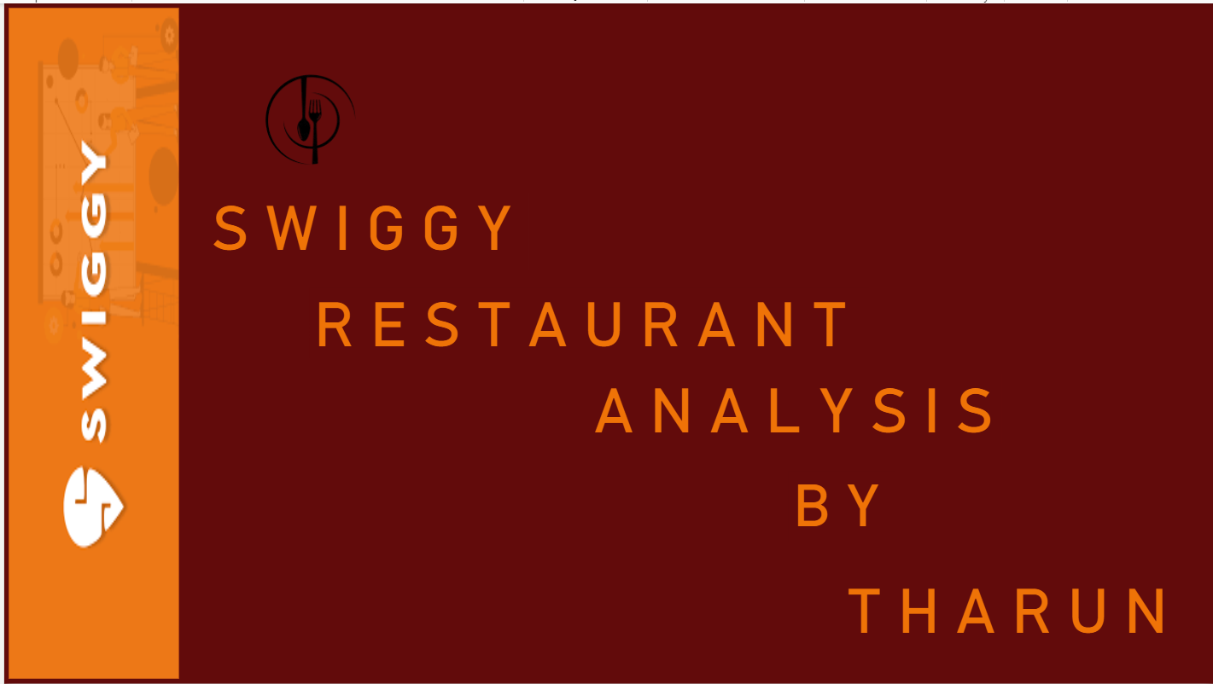
Front
Notes:
image
No alt text provided
image
No alt text provided
S W I G G Y
No alt text provided
R E S T A U R A N T
No alt text provided
A N A L Y S I S
No alt text provided
T H A R U N
No alt text provided

Slide 3
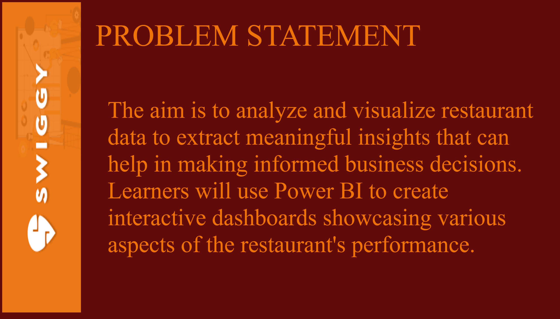
problem statment
Notes:
image
No alt text provided
PROBLEM STATEMENT
No alt text provided
textbox
No alt text provided

Slide 4
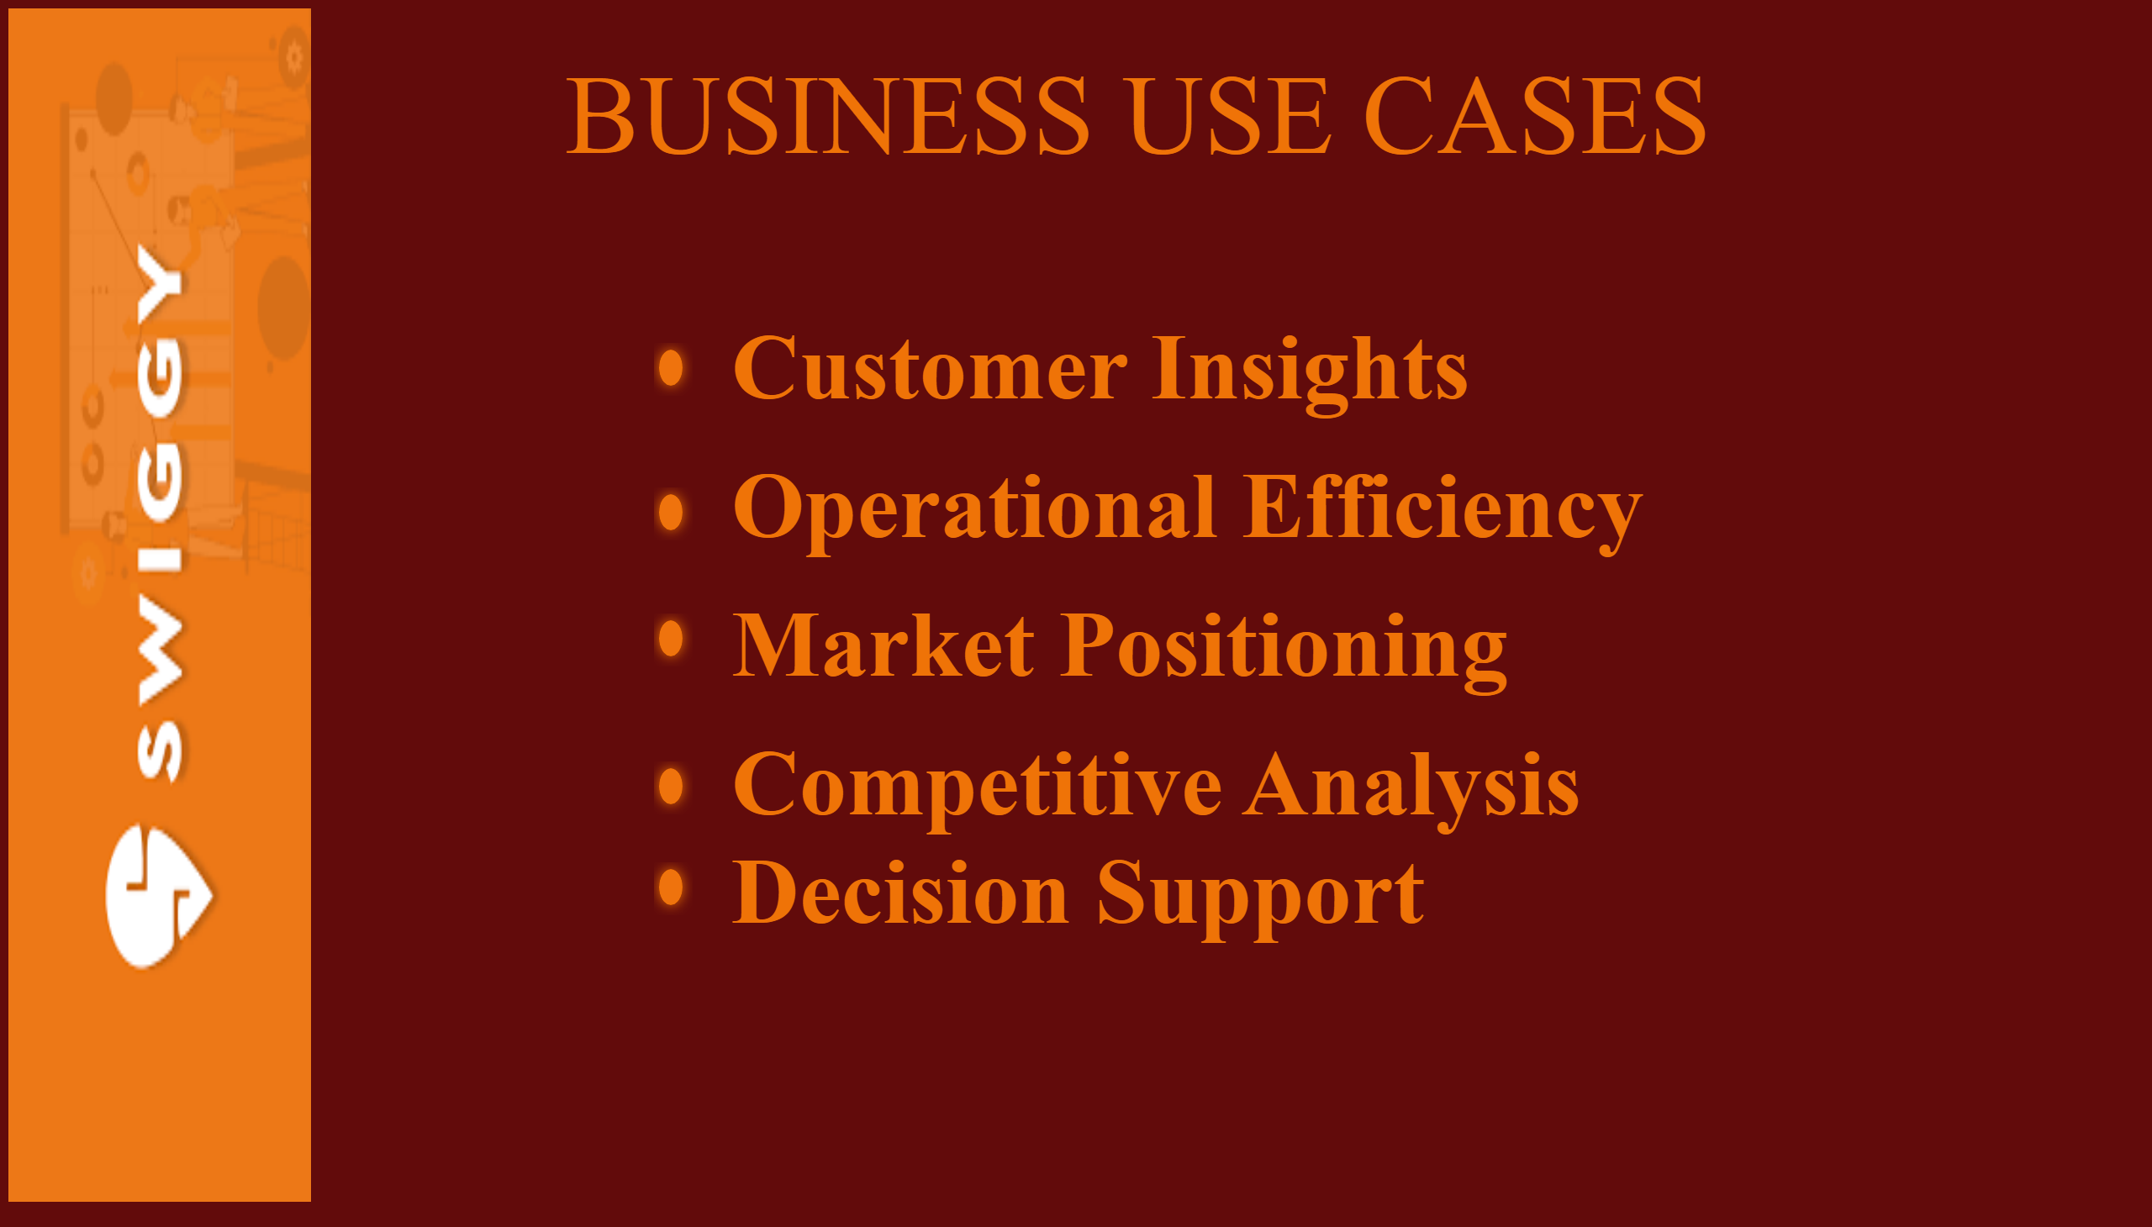
business use cause
Notes:
shape
No alt text provided
shape
No alt text provided
shape
No alt text provided
shape
No alt text provided
shape
No alt text provided
textbox
No alt text provided
BUSINESS USE CASES
No alt text provided
image
No alt text provided

Slide 5
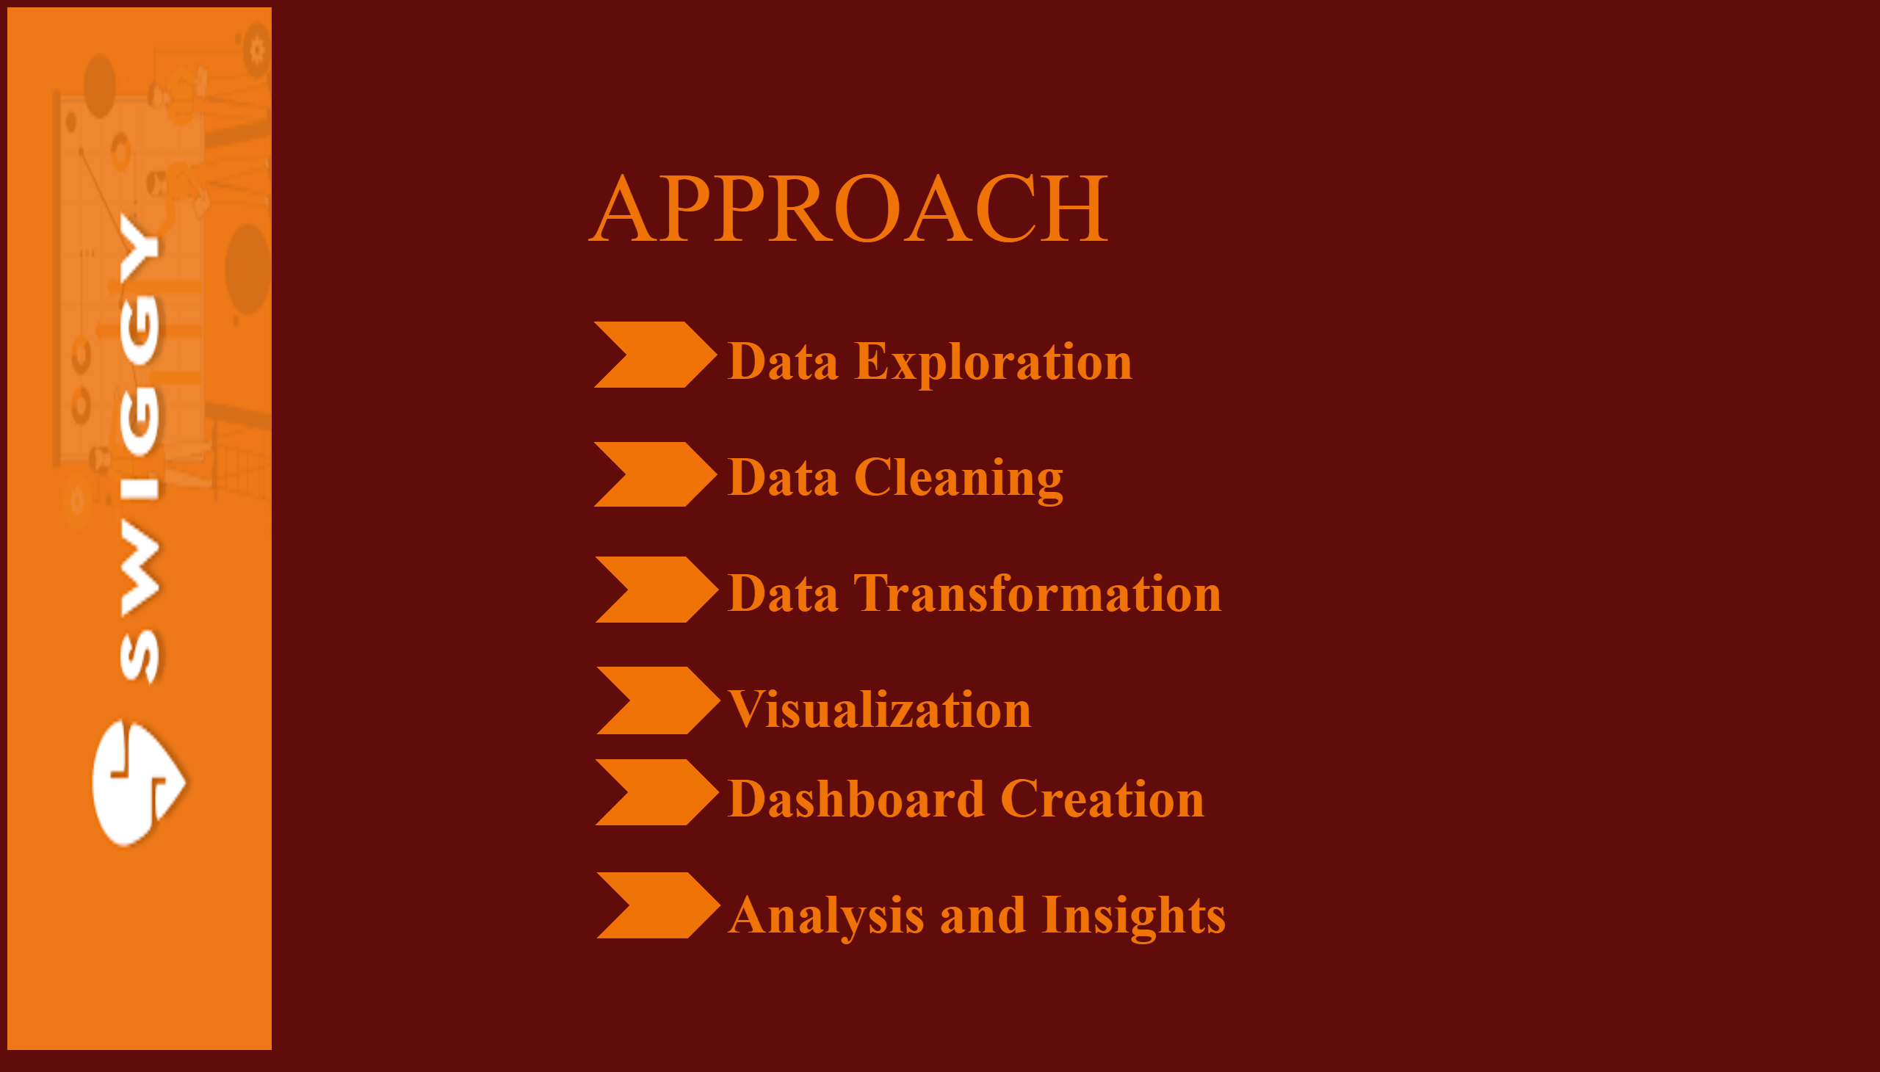
approach
Notes:
image
No alt text provided
textbox
No alt text provided
APPROACH
No alt text provided
shape
No alt text provided
shape
No alt text provided
shape
No alt text provided
shape
No alt text provided
shape
No alt text provided
shape
No alt text provided

Slide 6
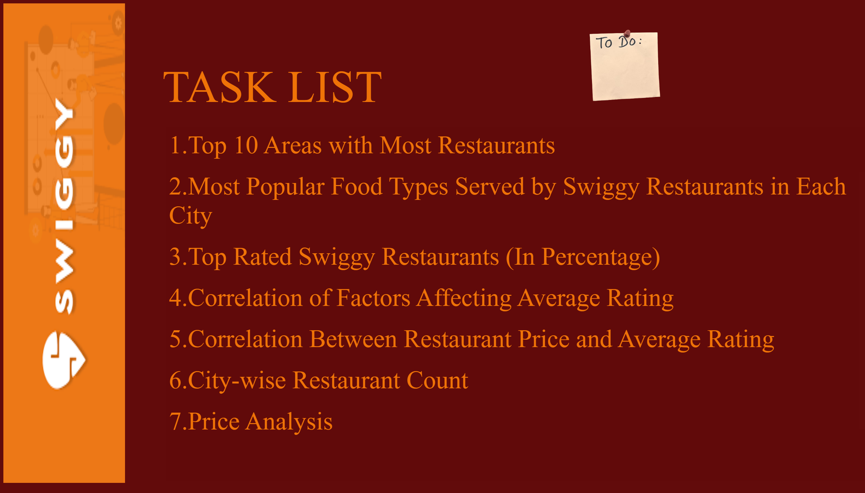
task
Notes:
image
No alt text provided
textbox
No alt text provided
TASK LIST
No alt text provided
image
No alt text provided

Slide 7
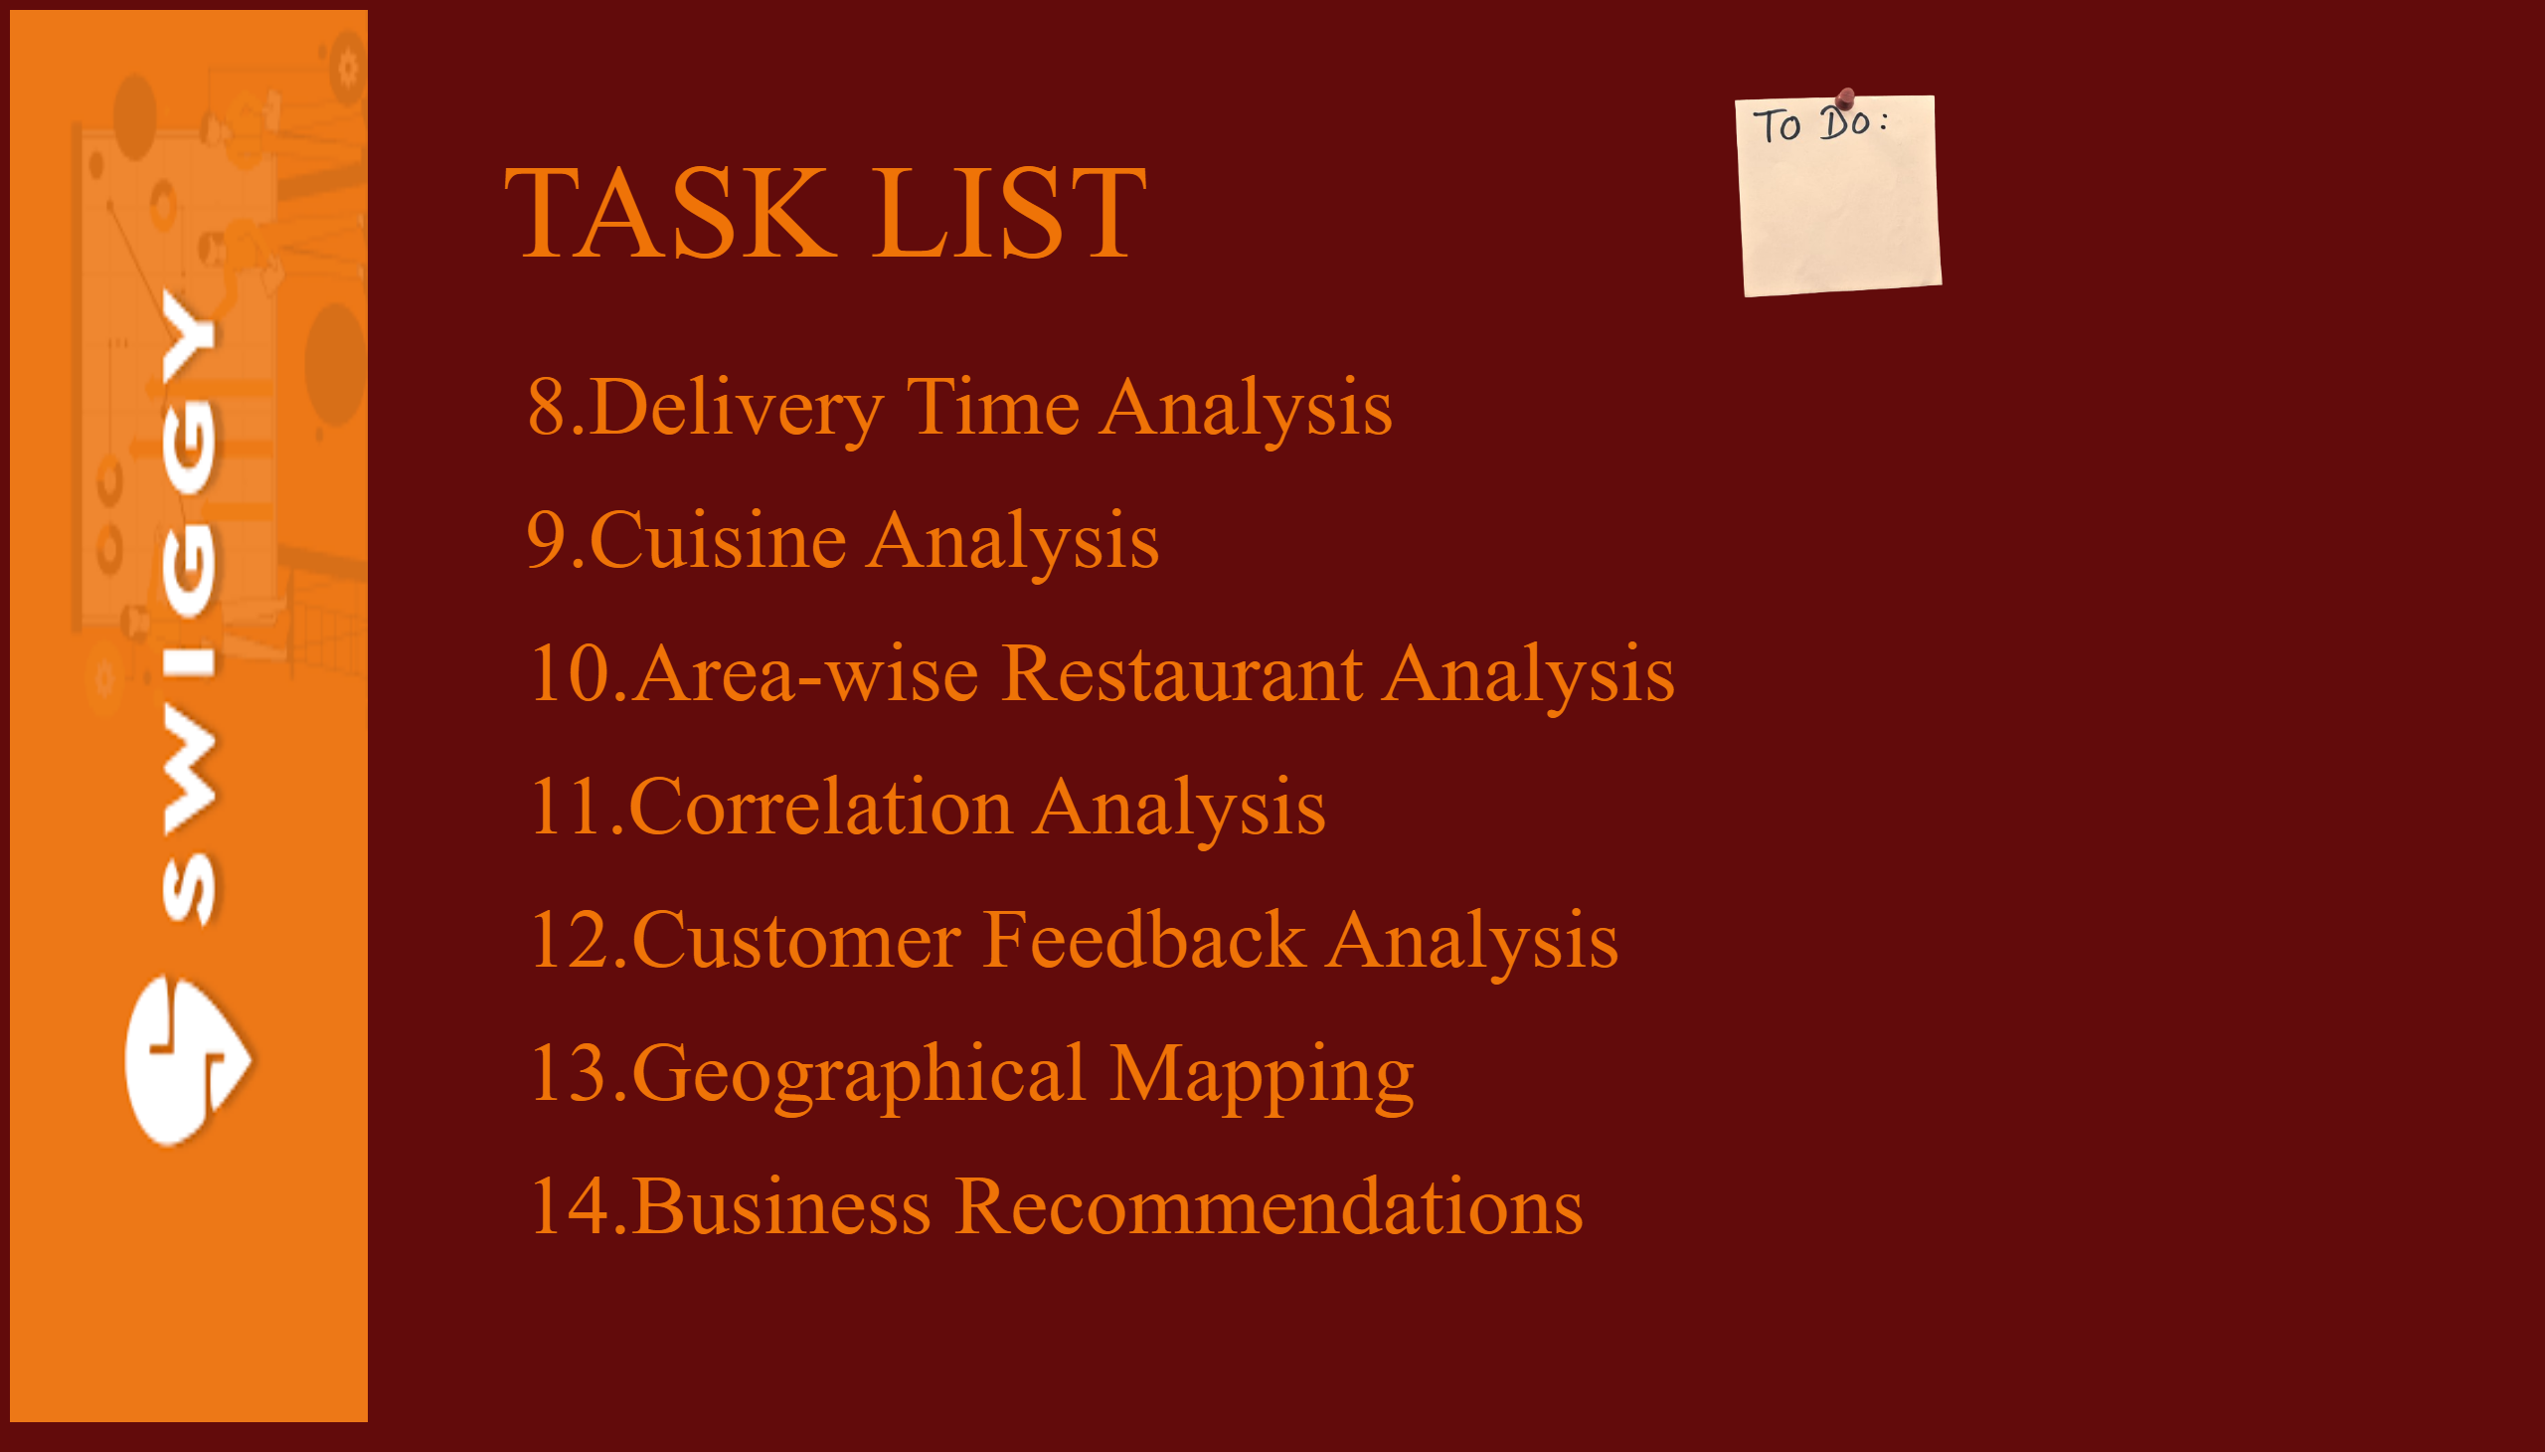
task
Notes:
TASK LIST
No alt text provided
image
No alt text provided
textbox
No alt text provided
image
No alt text provided

Slide 8
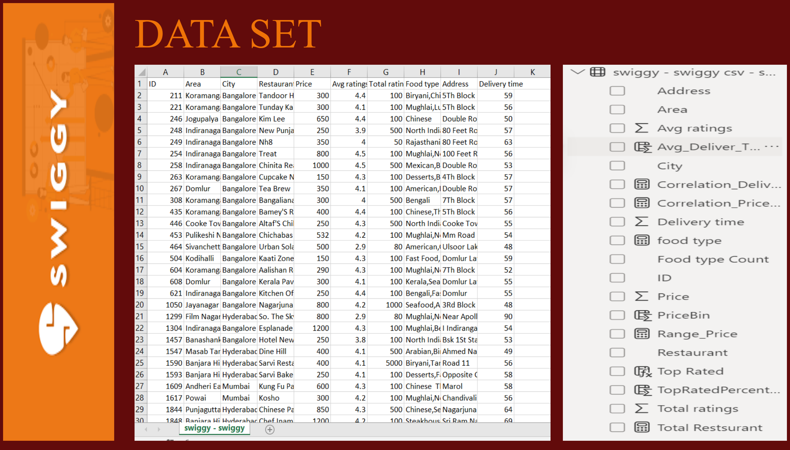
dataset
Notes:
image
No alt text provided
DATA SET
No alt text provided
image
No alt text provided
image
No alt text provided

Slide 9
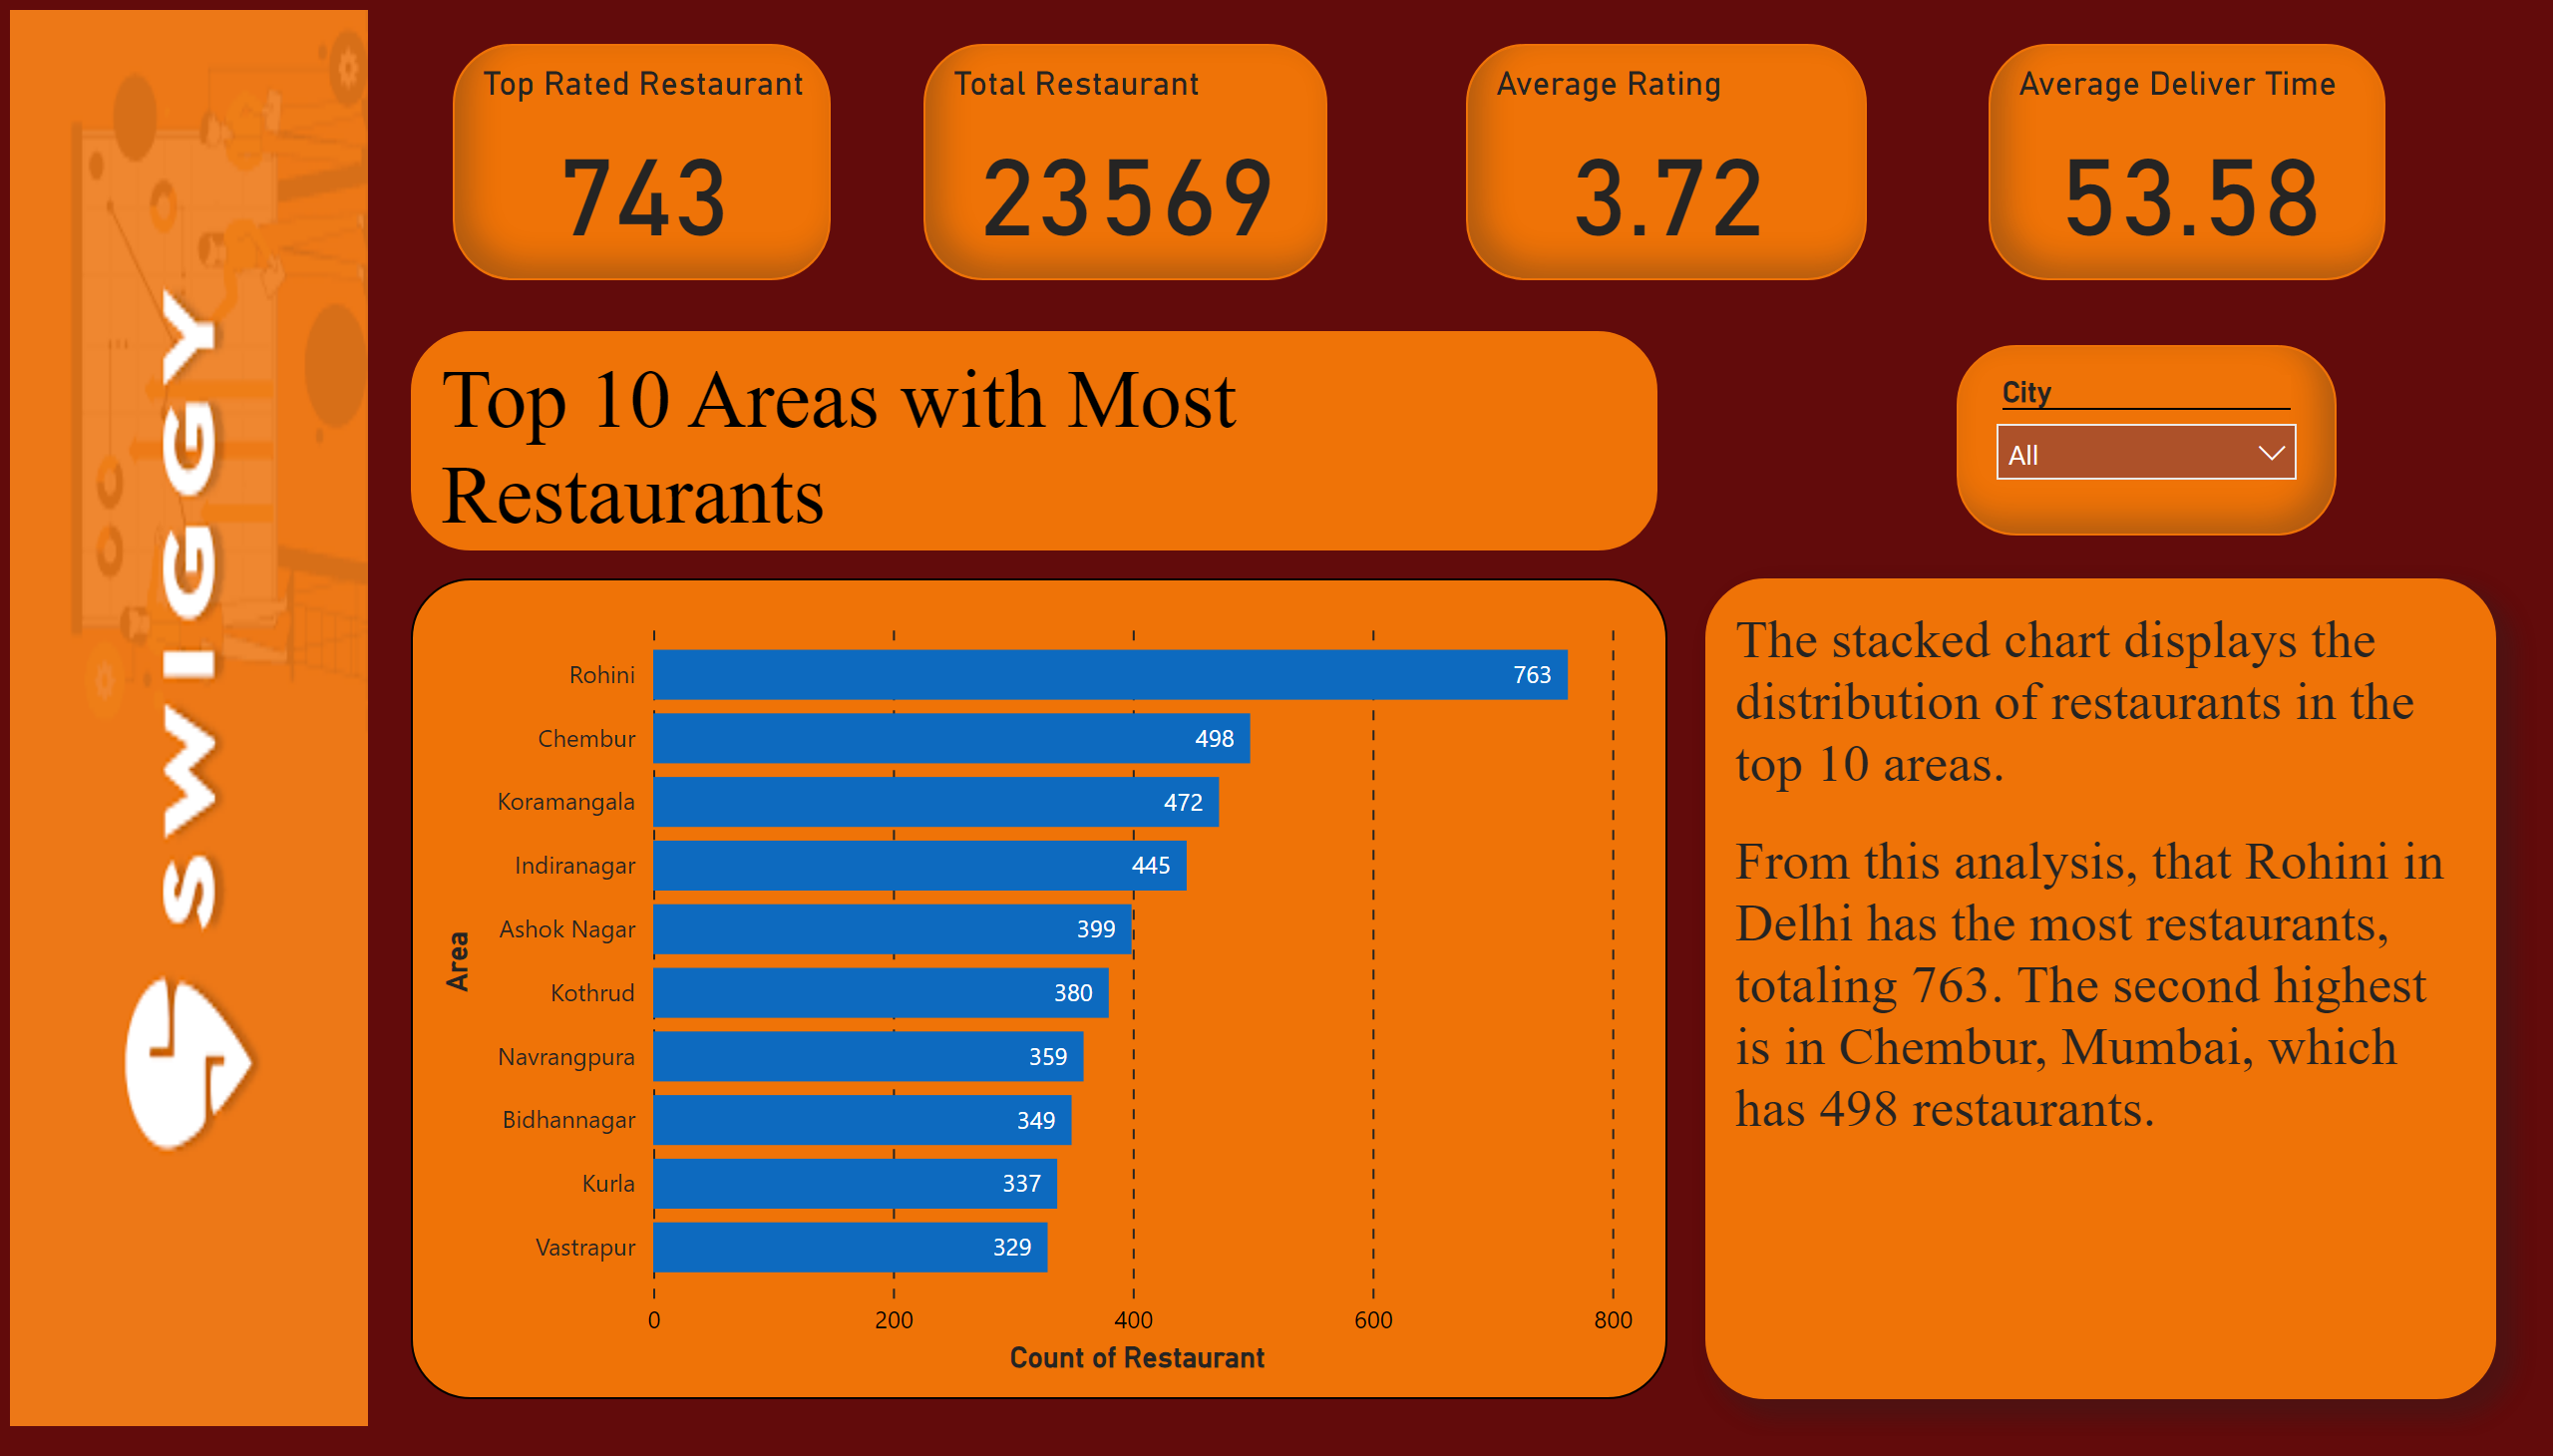
top 10 Area with RestaurenRestaurant
Notes:
barChart
No alt text provided
image
No alt text provided
Top Rated Restaurant
No alt text provided
slicer
No alt text provided
Total Restaurant
No alt text provided
Average Rating
No alt text provided
Average Deliver Time
No alt text provided
Top 10 Areas with Most Restaurants
No alt text provided
textbox
No alt text provided

Slide 10
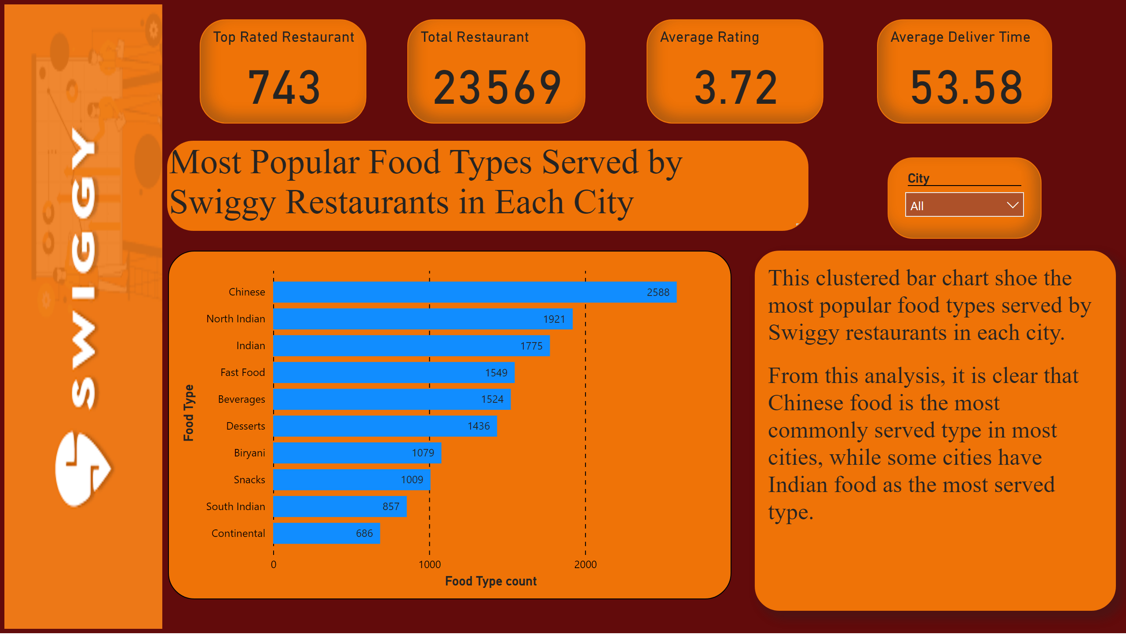
Most Popular Food Types Served by Swiggy Restaurants in Each City
Notes:
clusteredBarChart
No alt text provided
slicer
No alt text provided
Total Restaurant
No alt text provided
Average Rating
No alt text provided
Average Deliver Time
No alt text provided
Top Rated Restaurant
No alt text provided
image
No alt text provided
textbox
No alt text provided
Most Popular Food Types Served by Swiggy Restaurants in Each City
Most Popular Food Types Served by Swiggy Restaurants in Each City

Slide 11
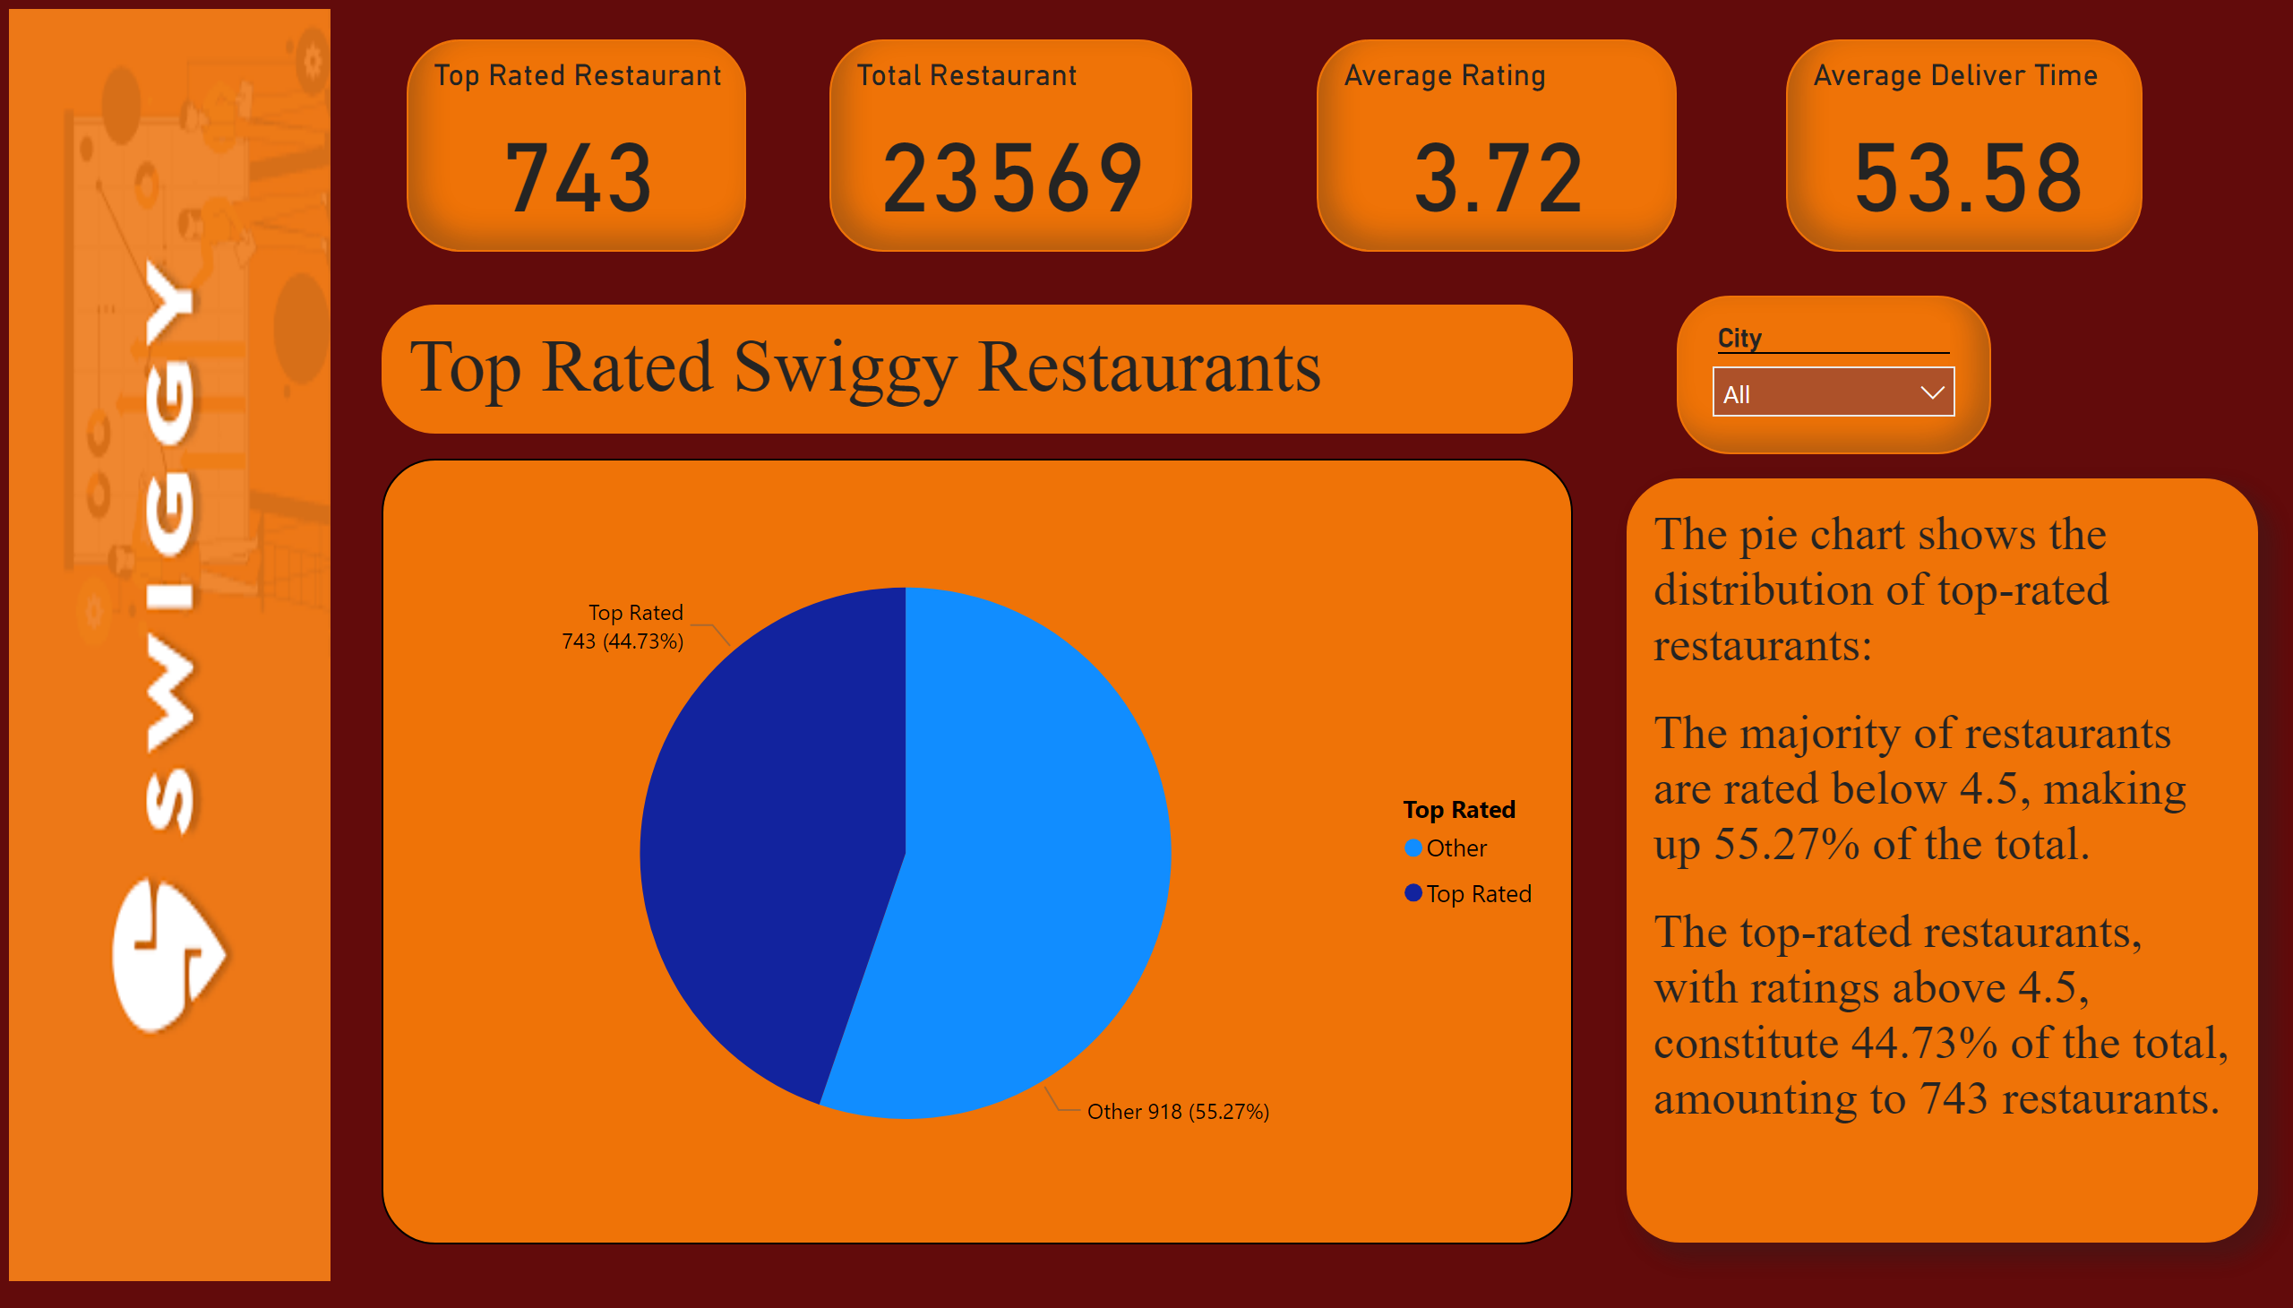
Top Rated Restaurant
Notes:
pieChart
No alt text provided
image
No alt text provided
Top Rated Restaurant
No alt text provided
Total Restaurant
No alt text provided
Average Rating
No alt text provided
Average Deliver Time
No alt text provided
slicer
No alt text provided
Top Rated Swiggy Restaurants
No alt text provided
textbox
No alt text provided

Slide 12
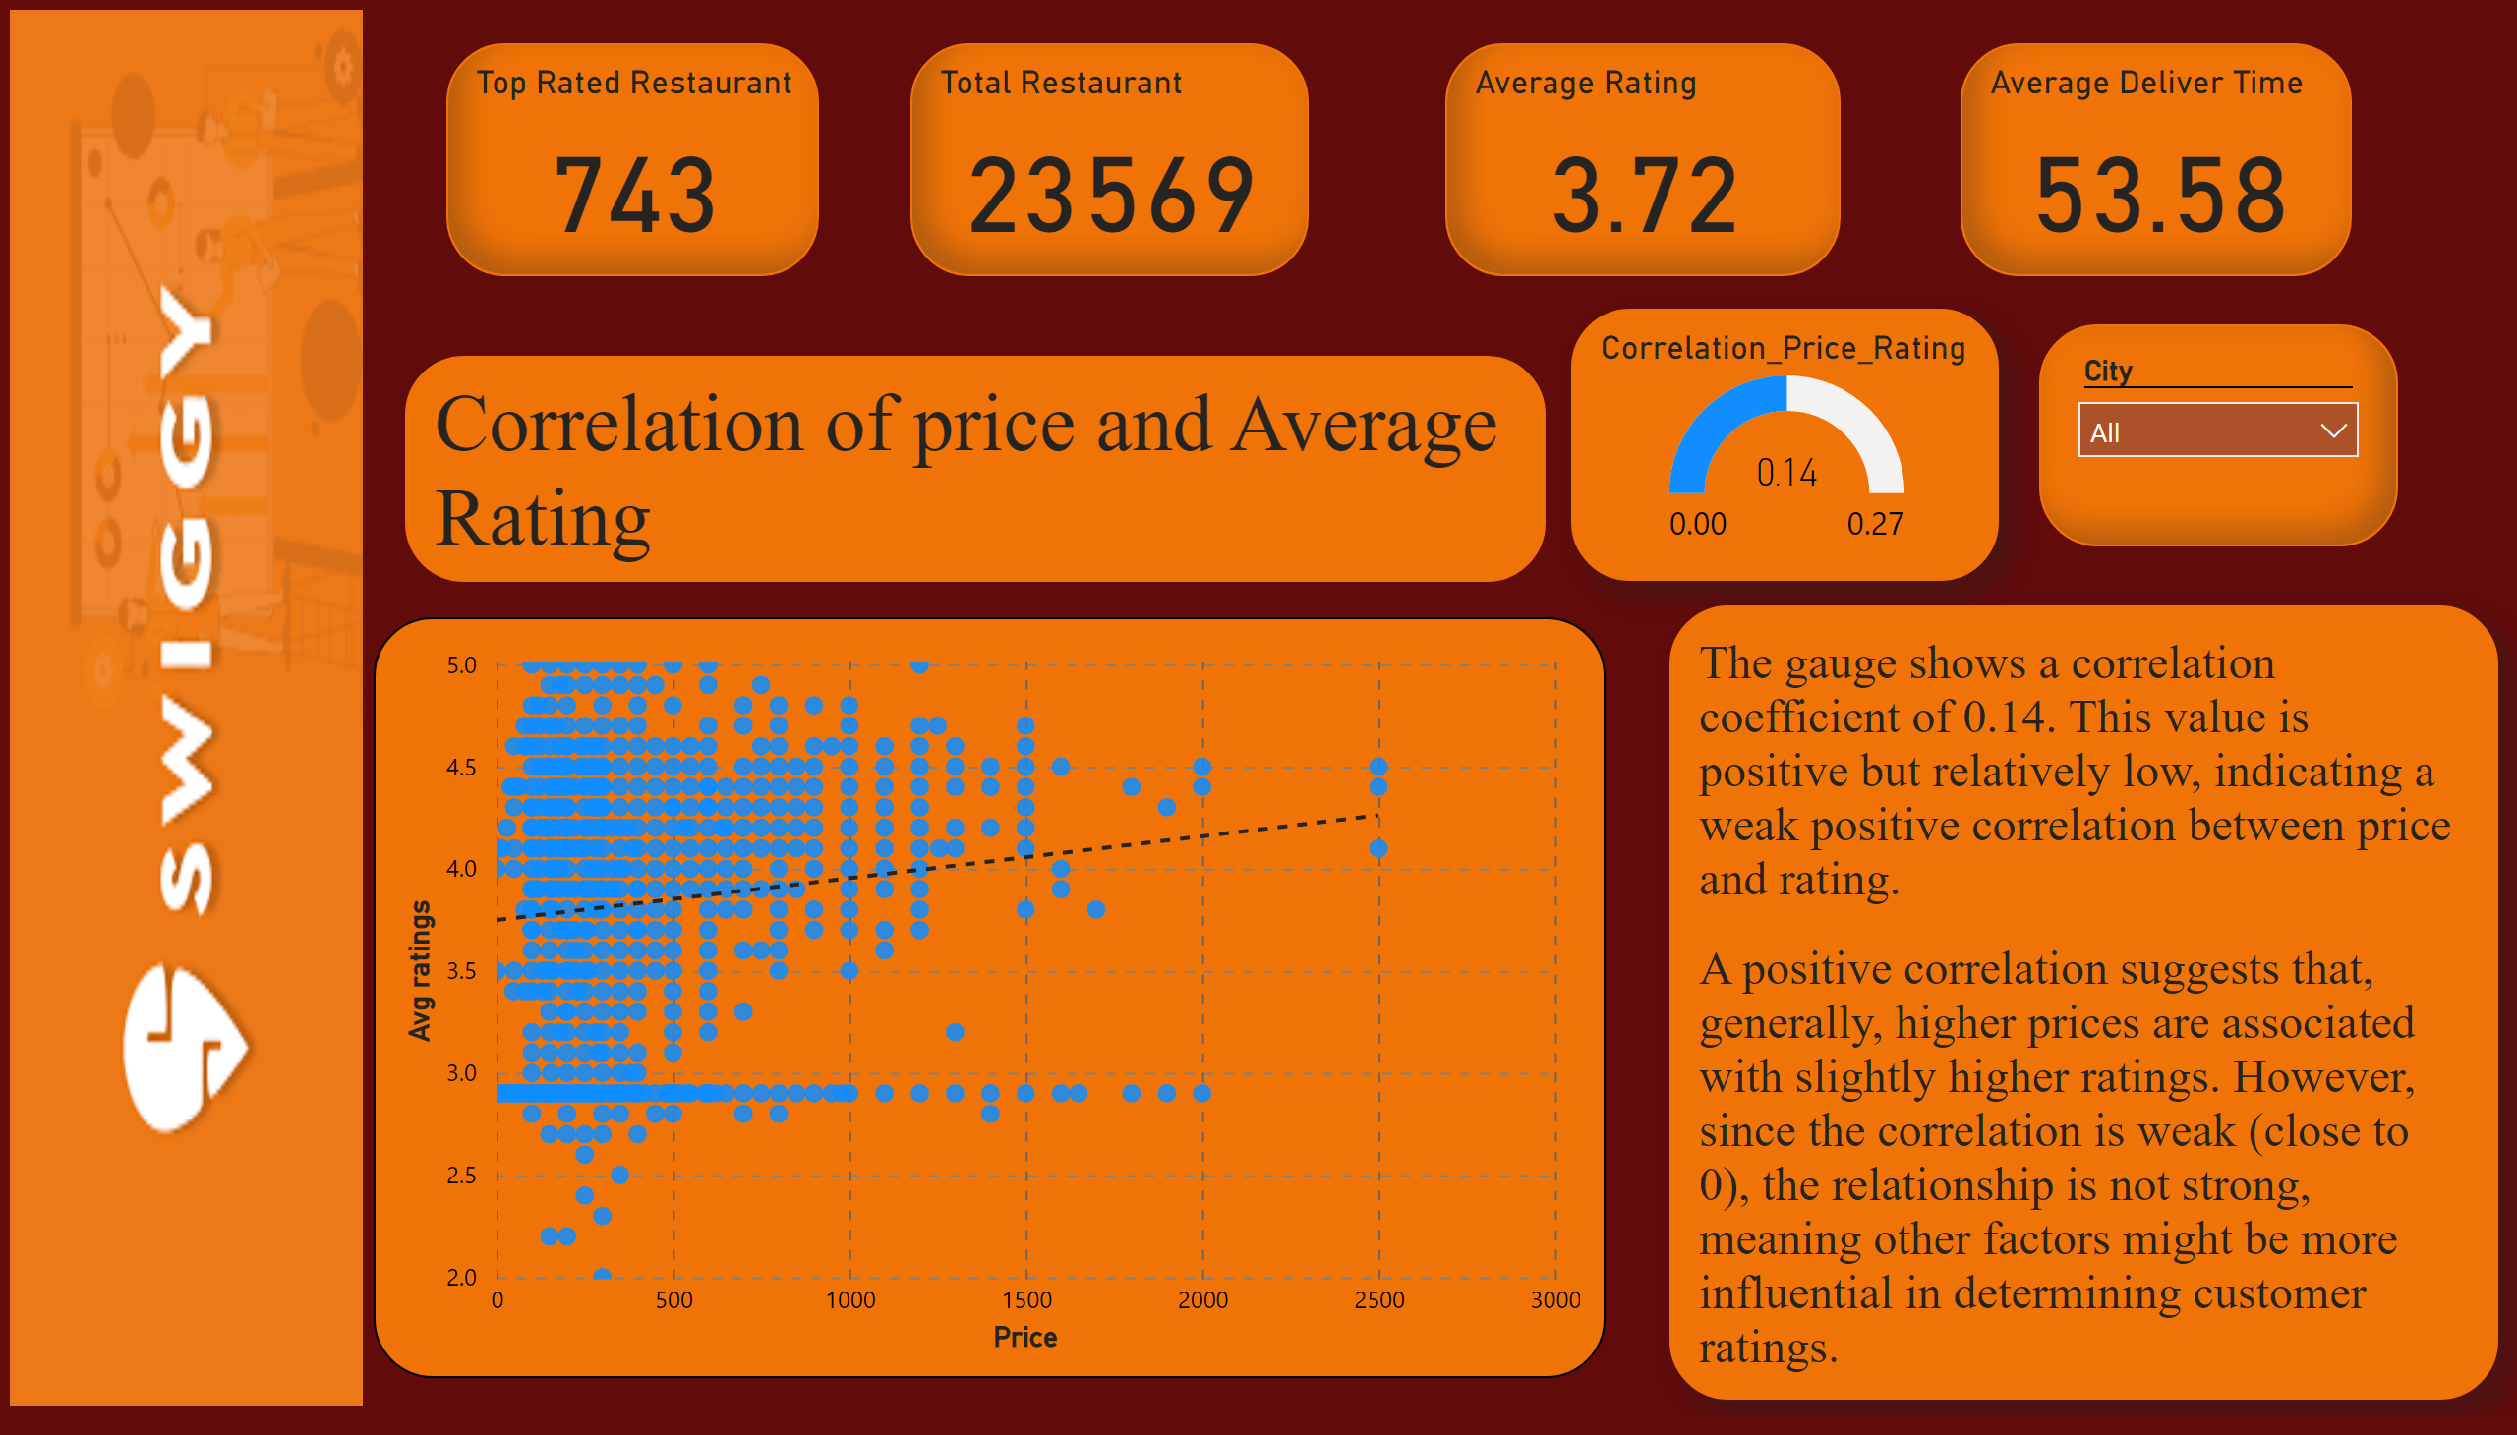
Correlation of Factors Affecting Average Rating
Notes:
gauge
No alt text provided
scatterChart
No alt text provided
image
No alt text provided
Total Restaurant
No alt text provided
Average Rating
No alt text provided
Average Deliver Time
No alt text provided
slicer
No alt text provided
Top Rated Restaurant
No alt text provided
Correlation of price and Average Rating
No alt text provided
textbox
No alt text provided

Slide 13
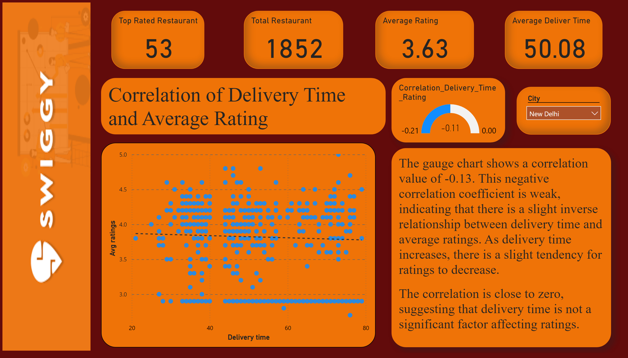
Corelation of Delivery and Average
Notes:
gauge
No alt text provided
scatterChart
No alt text provided
image
No alt text provided
Top Rated Restaurant
No alt text provided
Total Restaurant
No alt text provided
Average Rating
No alt text provided
Average Deliver Time
No alt text provided
slicer
No alt text provided
Correlation of Delivery Time and Average Rating
No alt text provided
textbox
No alt text provided

Slide 14
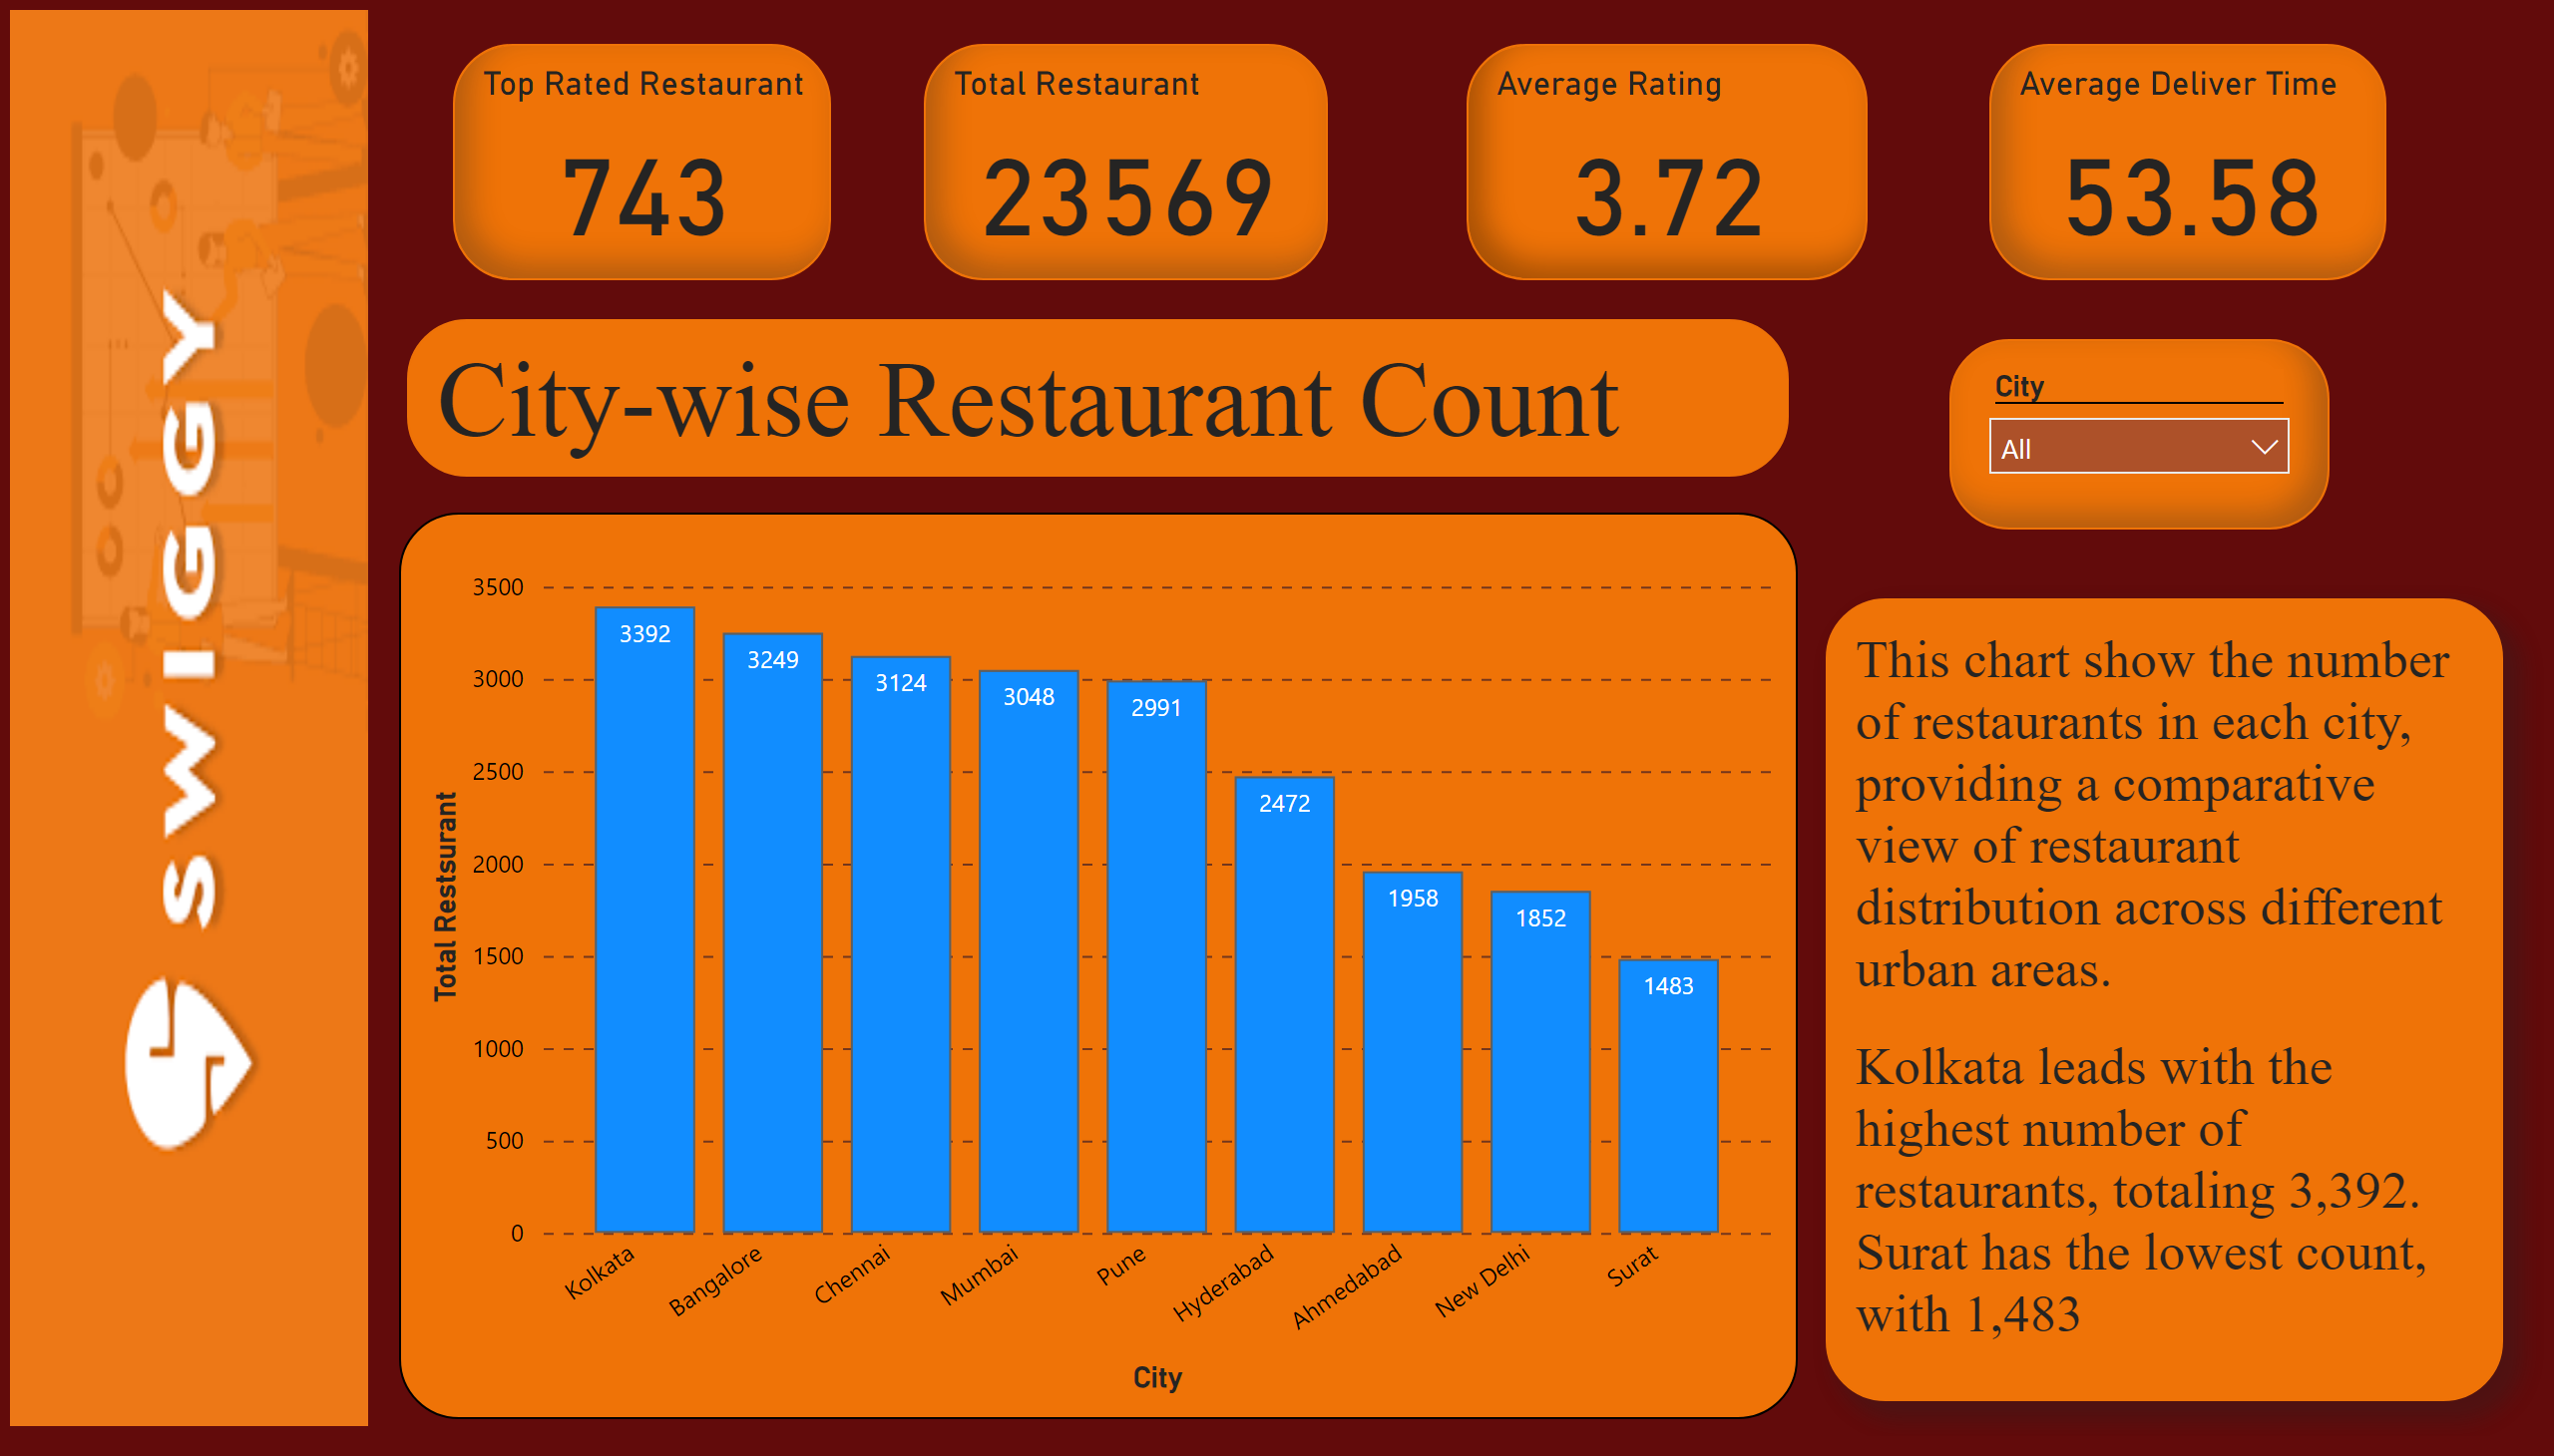
City with total Restaurant
Notes:
columnChart
No alt text provided
image
No alt text provided
Top Rated Restaurant
No alt text provided
Total Restaurant
No alt text provided
Average Rating
No alt text provided
Average Deliver Time
No alt text provided
slicer
No alt text provided
City-wise Restaurant Count
No alt text provided
textbox
No alt text provided

Slide 15
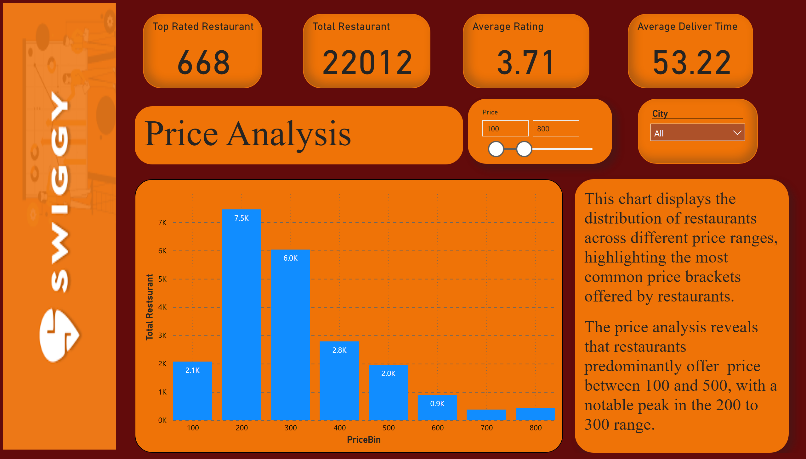
Price Analysis
Notes:
columnChart
No alt text provided
slicer
No alt text provided
image
No alt text provided
Top Rated Restaurant
No alt text provided
Total Restaurant
No alt text provided
Average Rating
No alt text provided
Average Deliver Time
No alt text provided
slicer
No alt text provided
textbox
No alt text provided
Price Analysis
No alt text provided

Slide 16
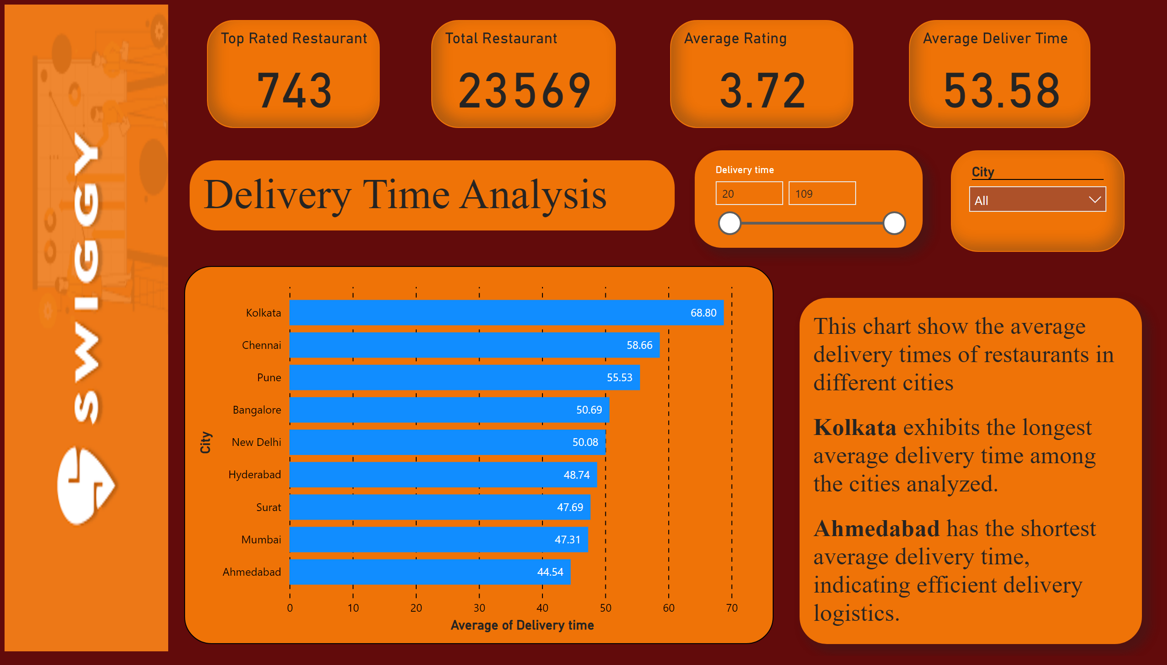
Delivery time analysis
Notes:
barChart
No alt text provided
slicer
No alt text provided
image
No alt text provided
Top Rated Restaurant
No alt text provided
Total Restaurant
No alt text provided
Average Rating
No alt text provided
Average Deliver Time
No alt text provided
slicer
No alt text provided
Delivery Time Analysis
No alt text provided
textbox
No alt text provided

Slide 17
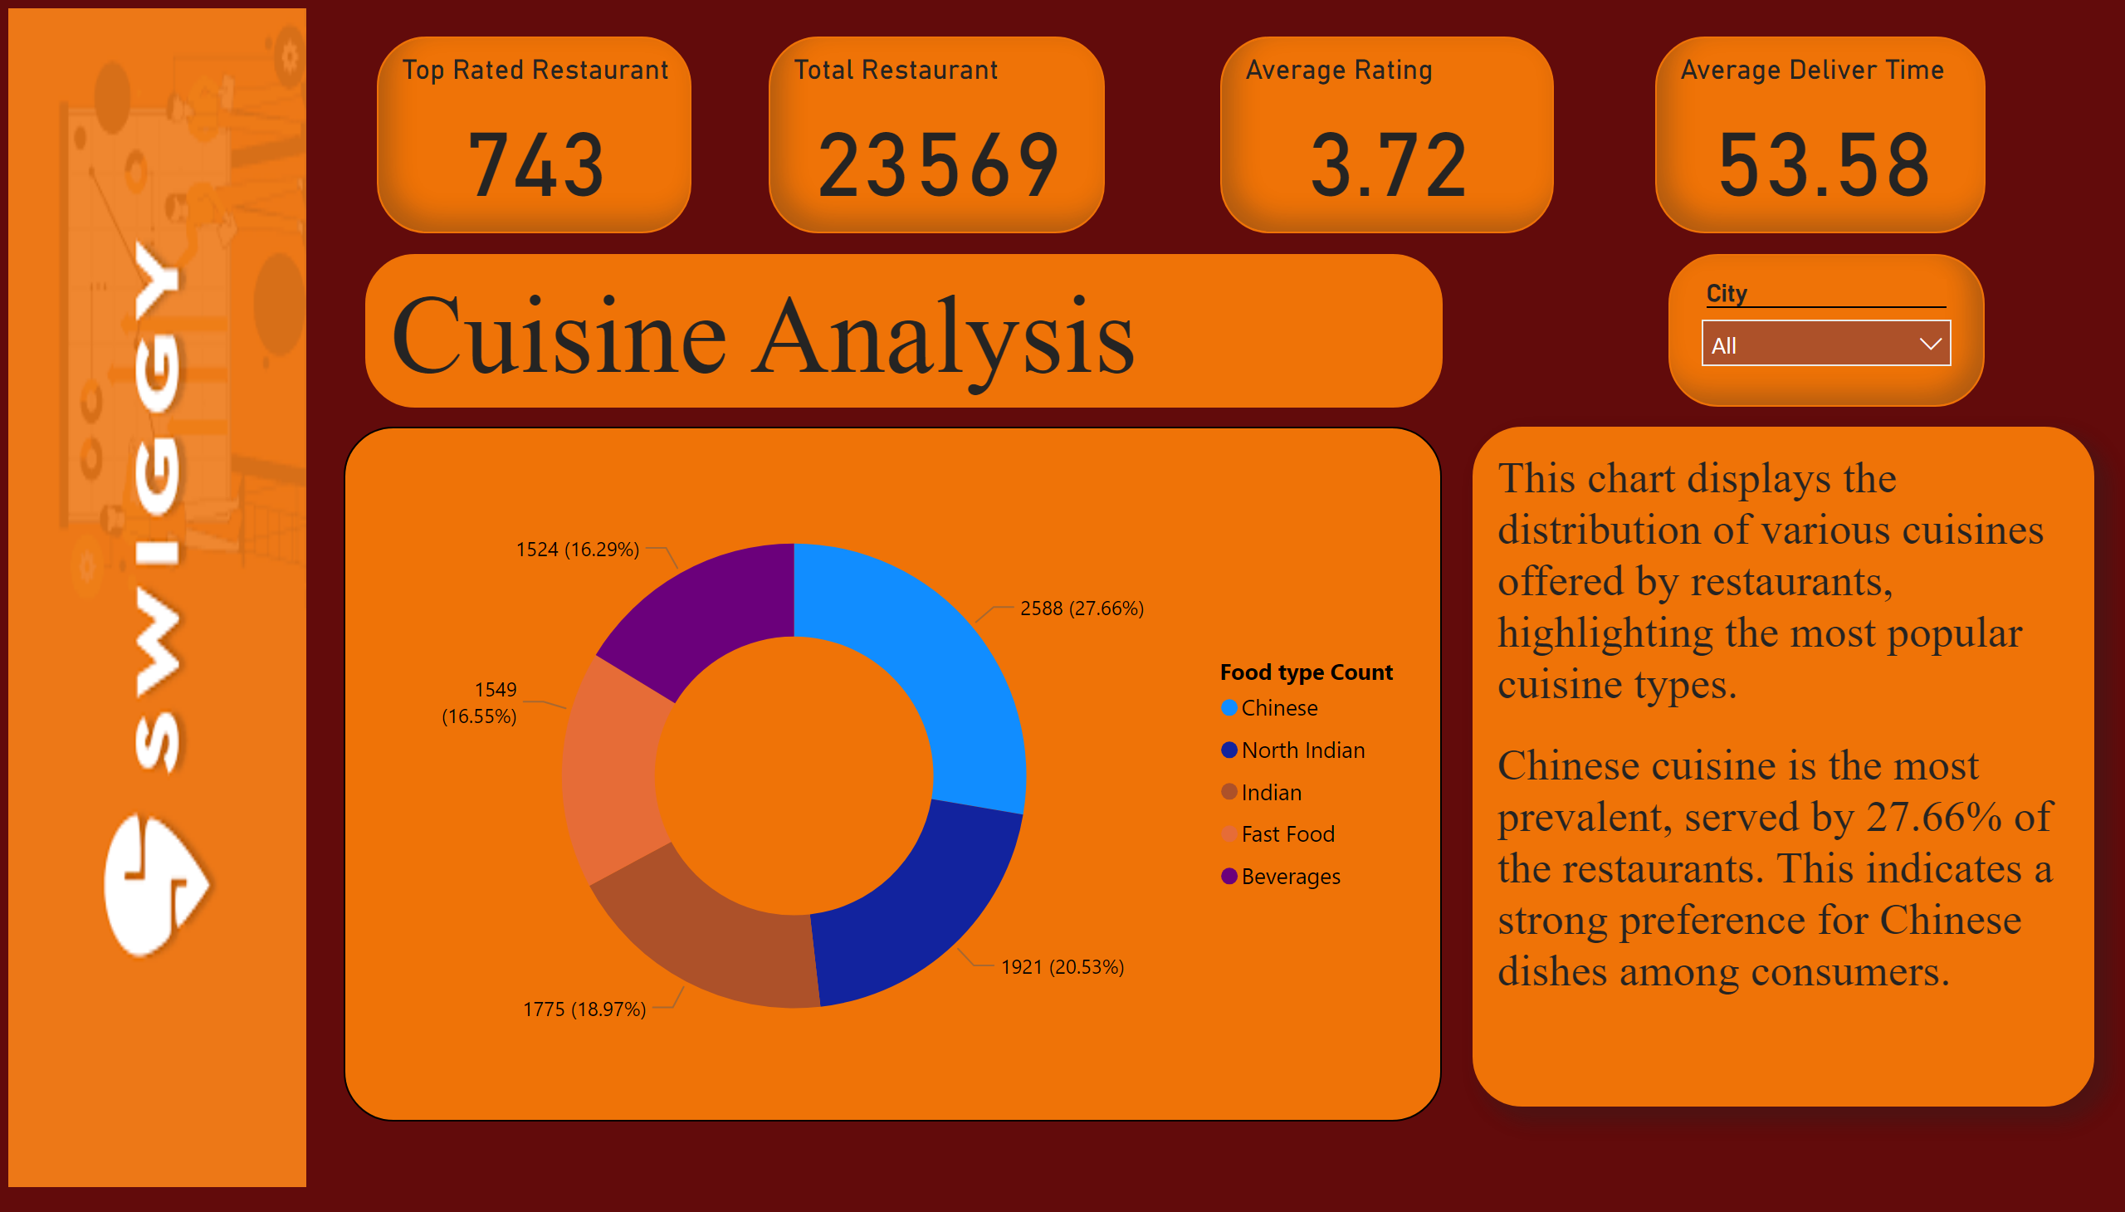
cuisine Analysis
Notes:
donutChart
No alt text provided
image
No alt text provided
Top Rated Restaurant
No alt text provided
Total Restaurant
No alt text provided
Average Rating
No alt text provided
Average Deliver Time
No alt text provided
slicer
No alt text provided
Cuisine Analysis
No alt text provided
textbox
No alt text provided

Slide 18
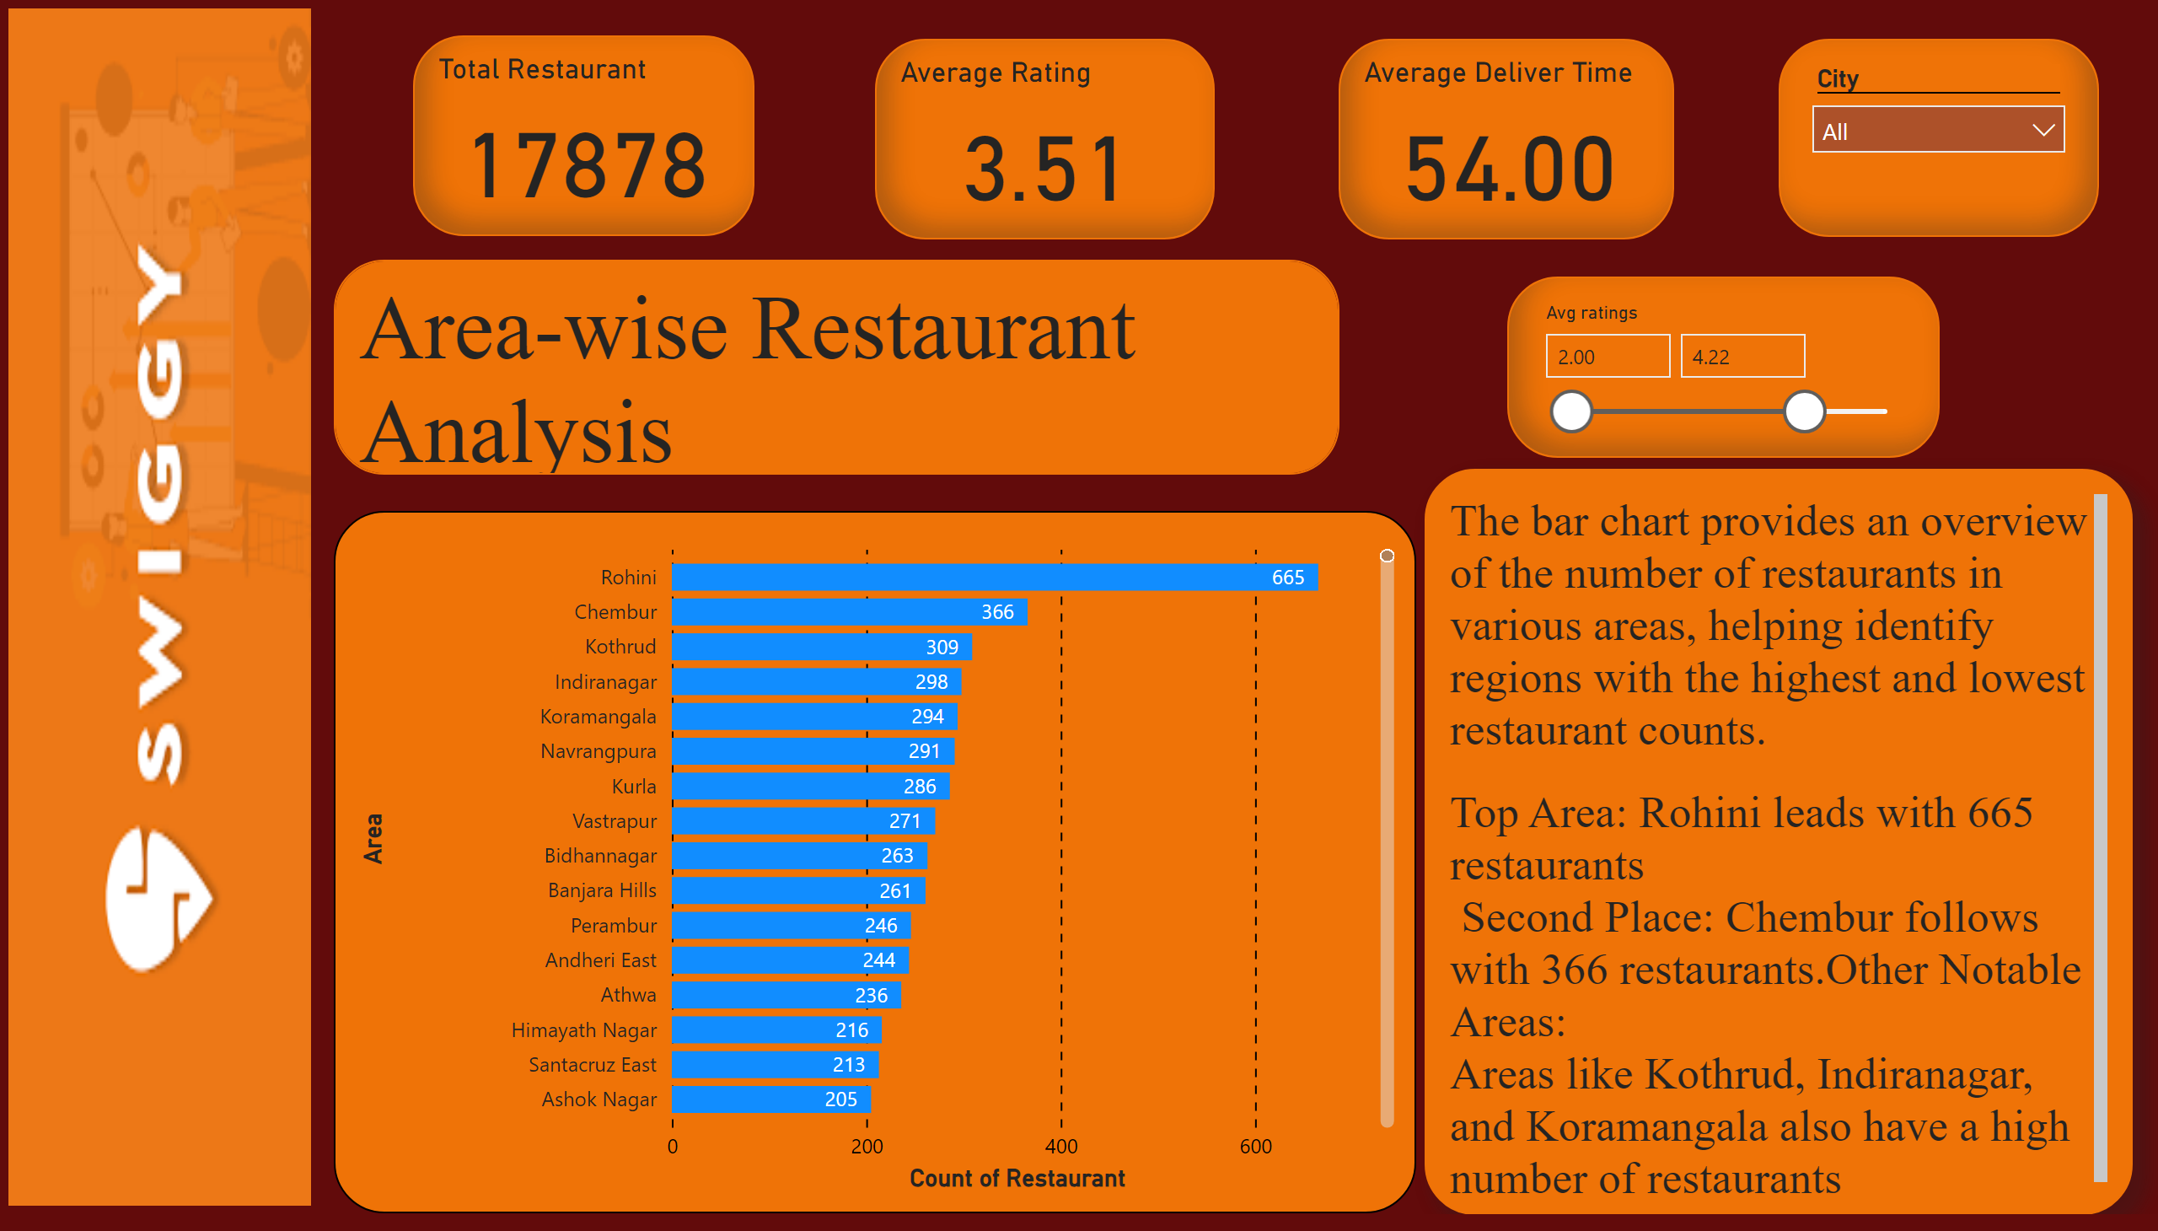
Area-wise Restaurant Analysis
Notes:
clusteredBarChart
No alt text provided
slicer
No alt text provided
image
No alt text provided
Average Rating
No alt text provided
Average Deliver Time
No alt text provided
Total Restaurant
No alt text provided
slicer
No alt text provided
Area-wise Restaurant Analysis
No alt text provided
textbox
No alt text provided

Slide 19
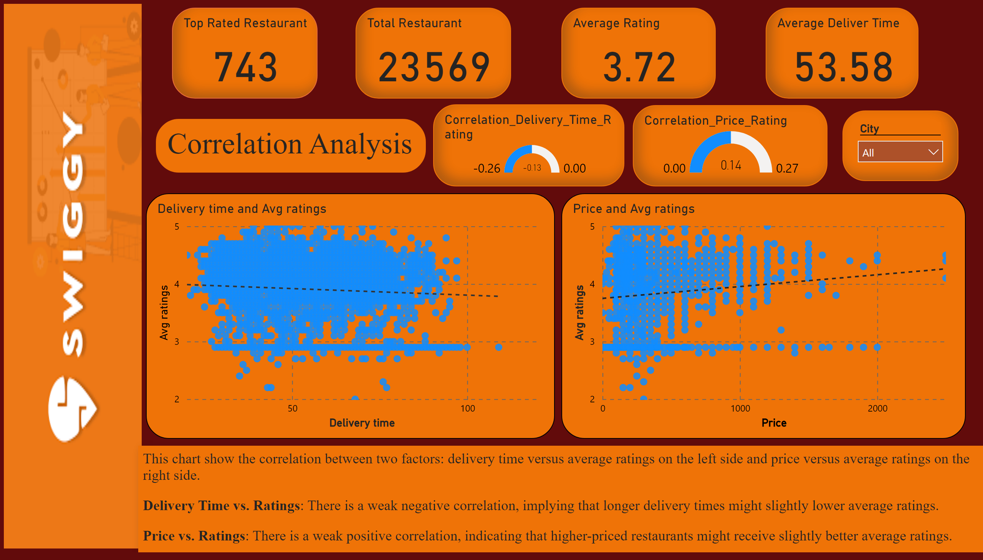
Correlation Analysis
Notes:
scatterChart
No alt text provided
scatterChart
No alt text provided
gauge
No alt text provided
gauge
No alt text provided
image
No alt text provided
Top Rated Restaurant
No alt text provided
Total Restaurant
No alt text provided
Average Rating
No alt text provided
Average Deliver Time
No alt text provided
slicer
No alt text provided
Correlation Analysis
No alt text provided
textbox
No alt text provided

Slide 20
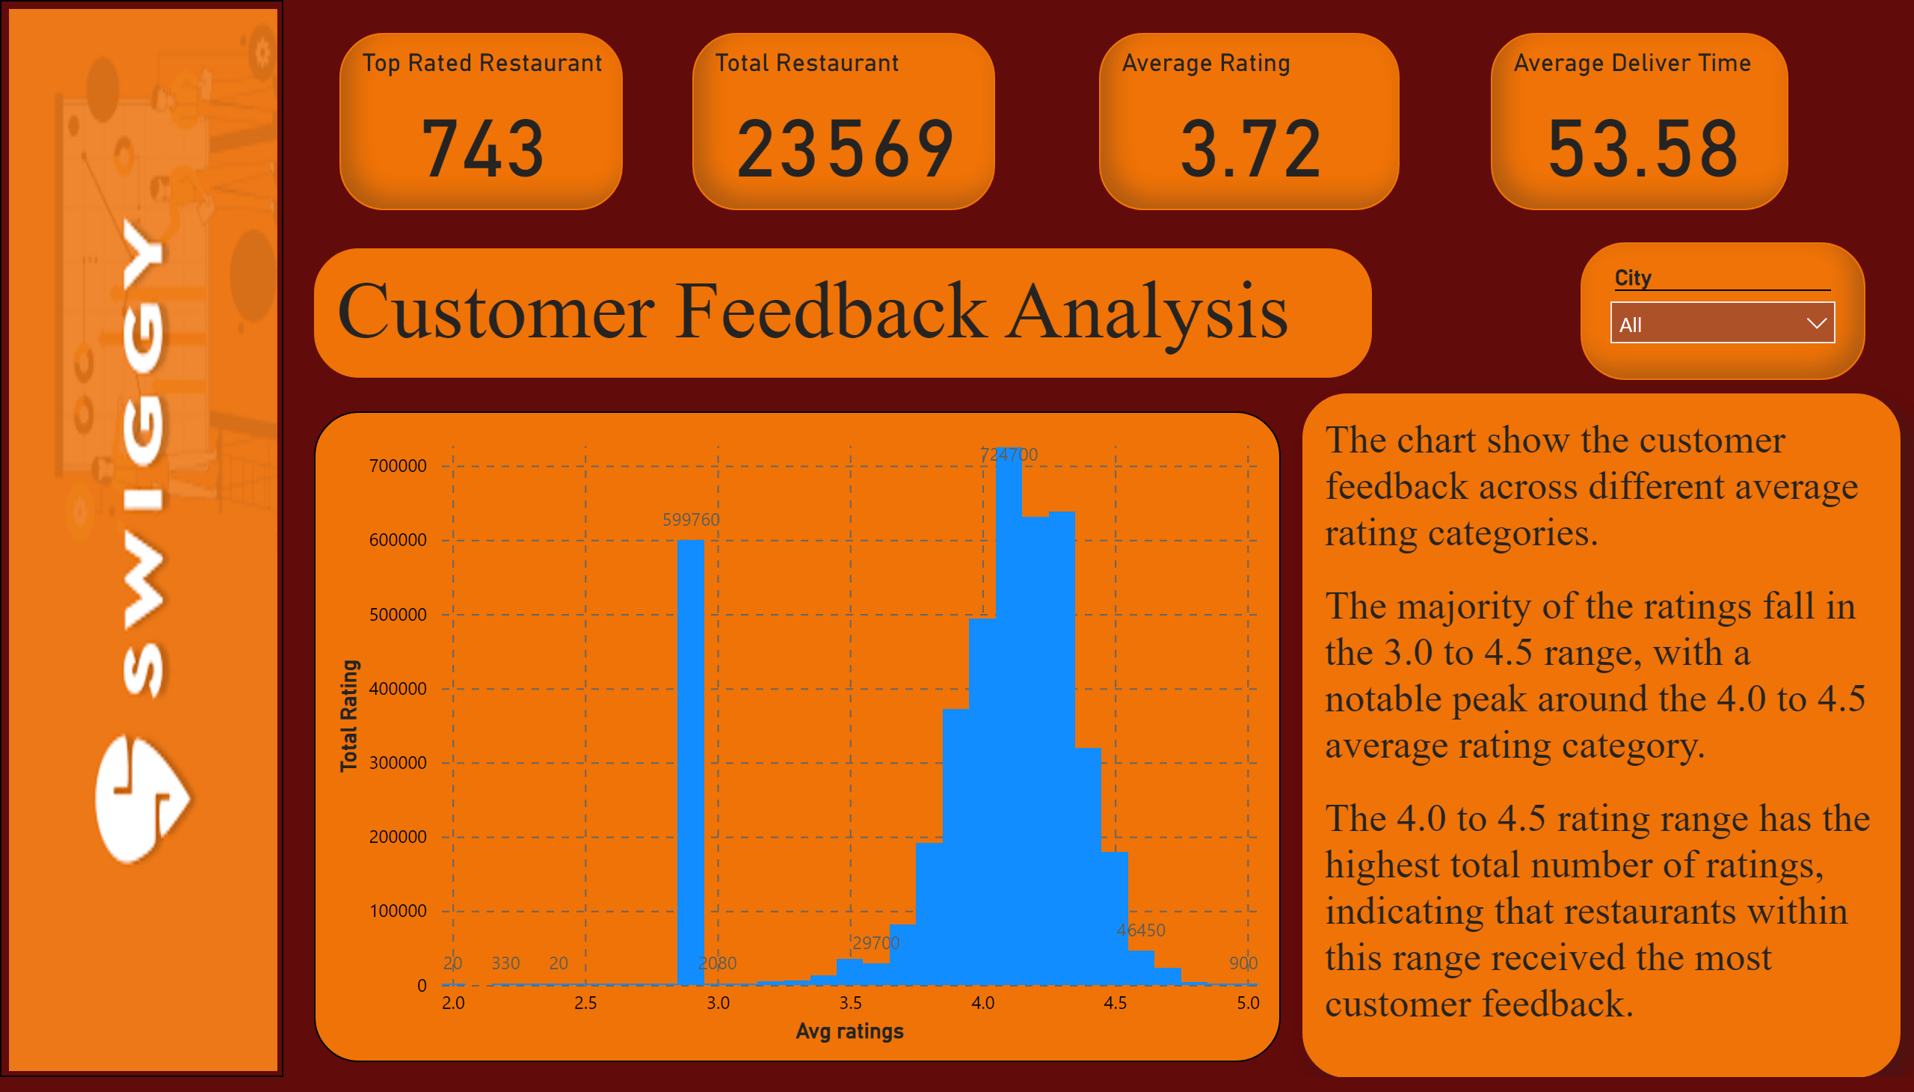
Customer Feedback Analysis
Notes:
columnChart
No alt text provided
image
No alt text provided
Top Rated Restaurant
No alt text provided
Total Restaurant
No alt text provided
Average Rating
No alt text provided
Average Deliver Time
No alt text provided
slicer
No alt text provided
Customer Feedback Analysis
No alt text provided
textbox
No alt text provided

Slide 21
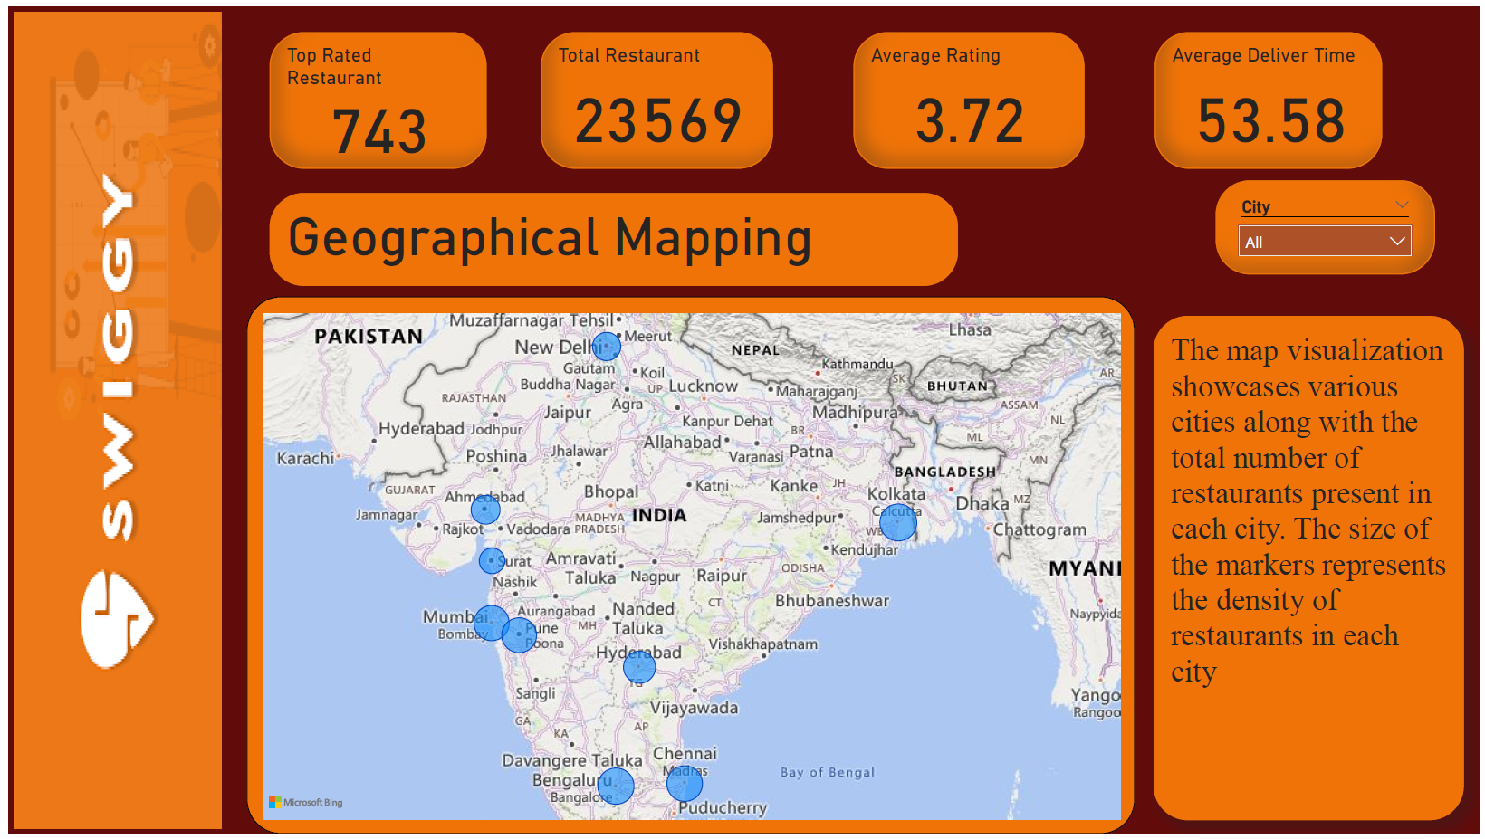
Geographical Mapping
Notes:
image
No alt text provided
Top Rated Restaurant
No alt text provided
Total Restaurant
No alt text provided
Average Rating
No alt text provided
Average Deliver Time
No alt text provided
slicer
No alt text provided
Geographical Mapping
No alt text provided
textbox
No alt text provided
map
No alt text provided

Slide 22
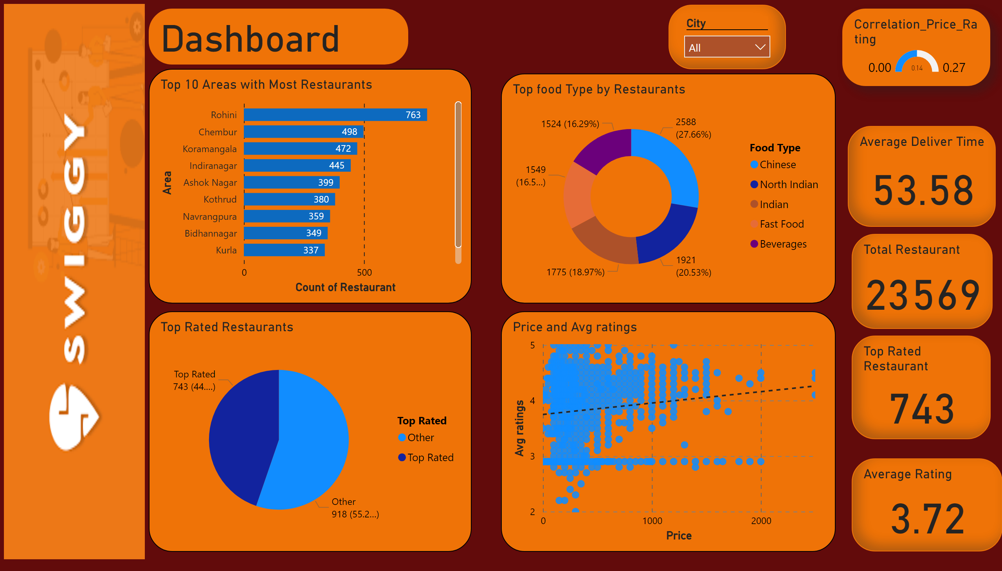
DashboarDashboards
Notes:
image
No alt text provided
Dashboard
No alt text provided
Top Rated Restaurant
No alt text provided
Total Restaurant
No alt text provided
Average Rating
No alt text provided
Average Deliver Time
No alt text provided
slicer
No alt text provided
Top 10 Areas with Most Restaurants
No alt text provided
Top Rated Restaurants
No alt text provided
scatterChart
No alt text provided
Top food Type by Restaurants
No alt text provided
gauge
No alt text provided

Slide 23
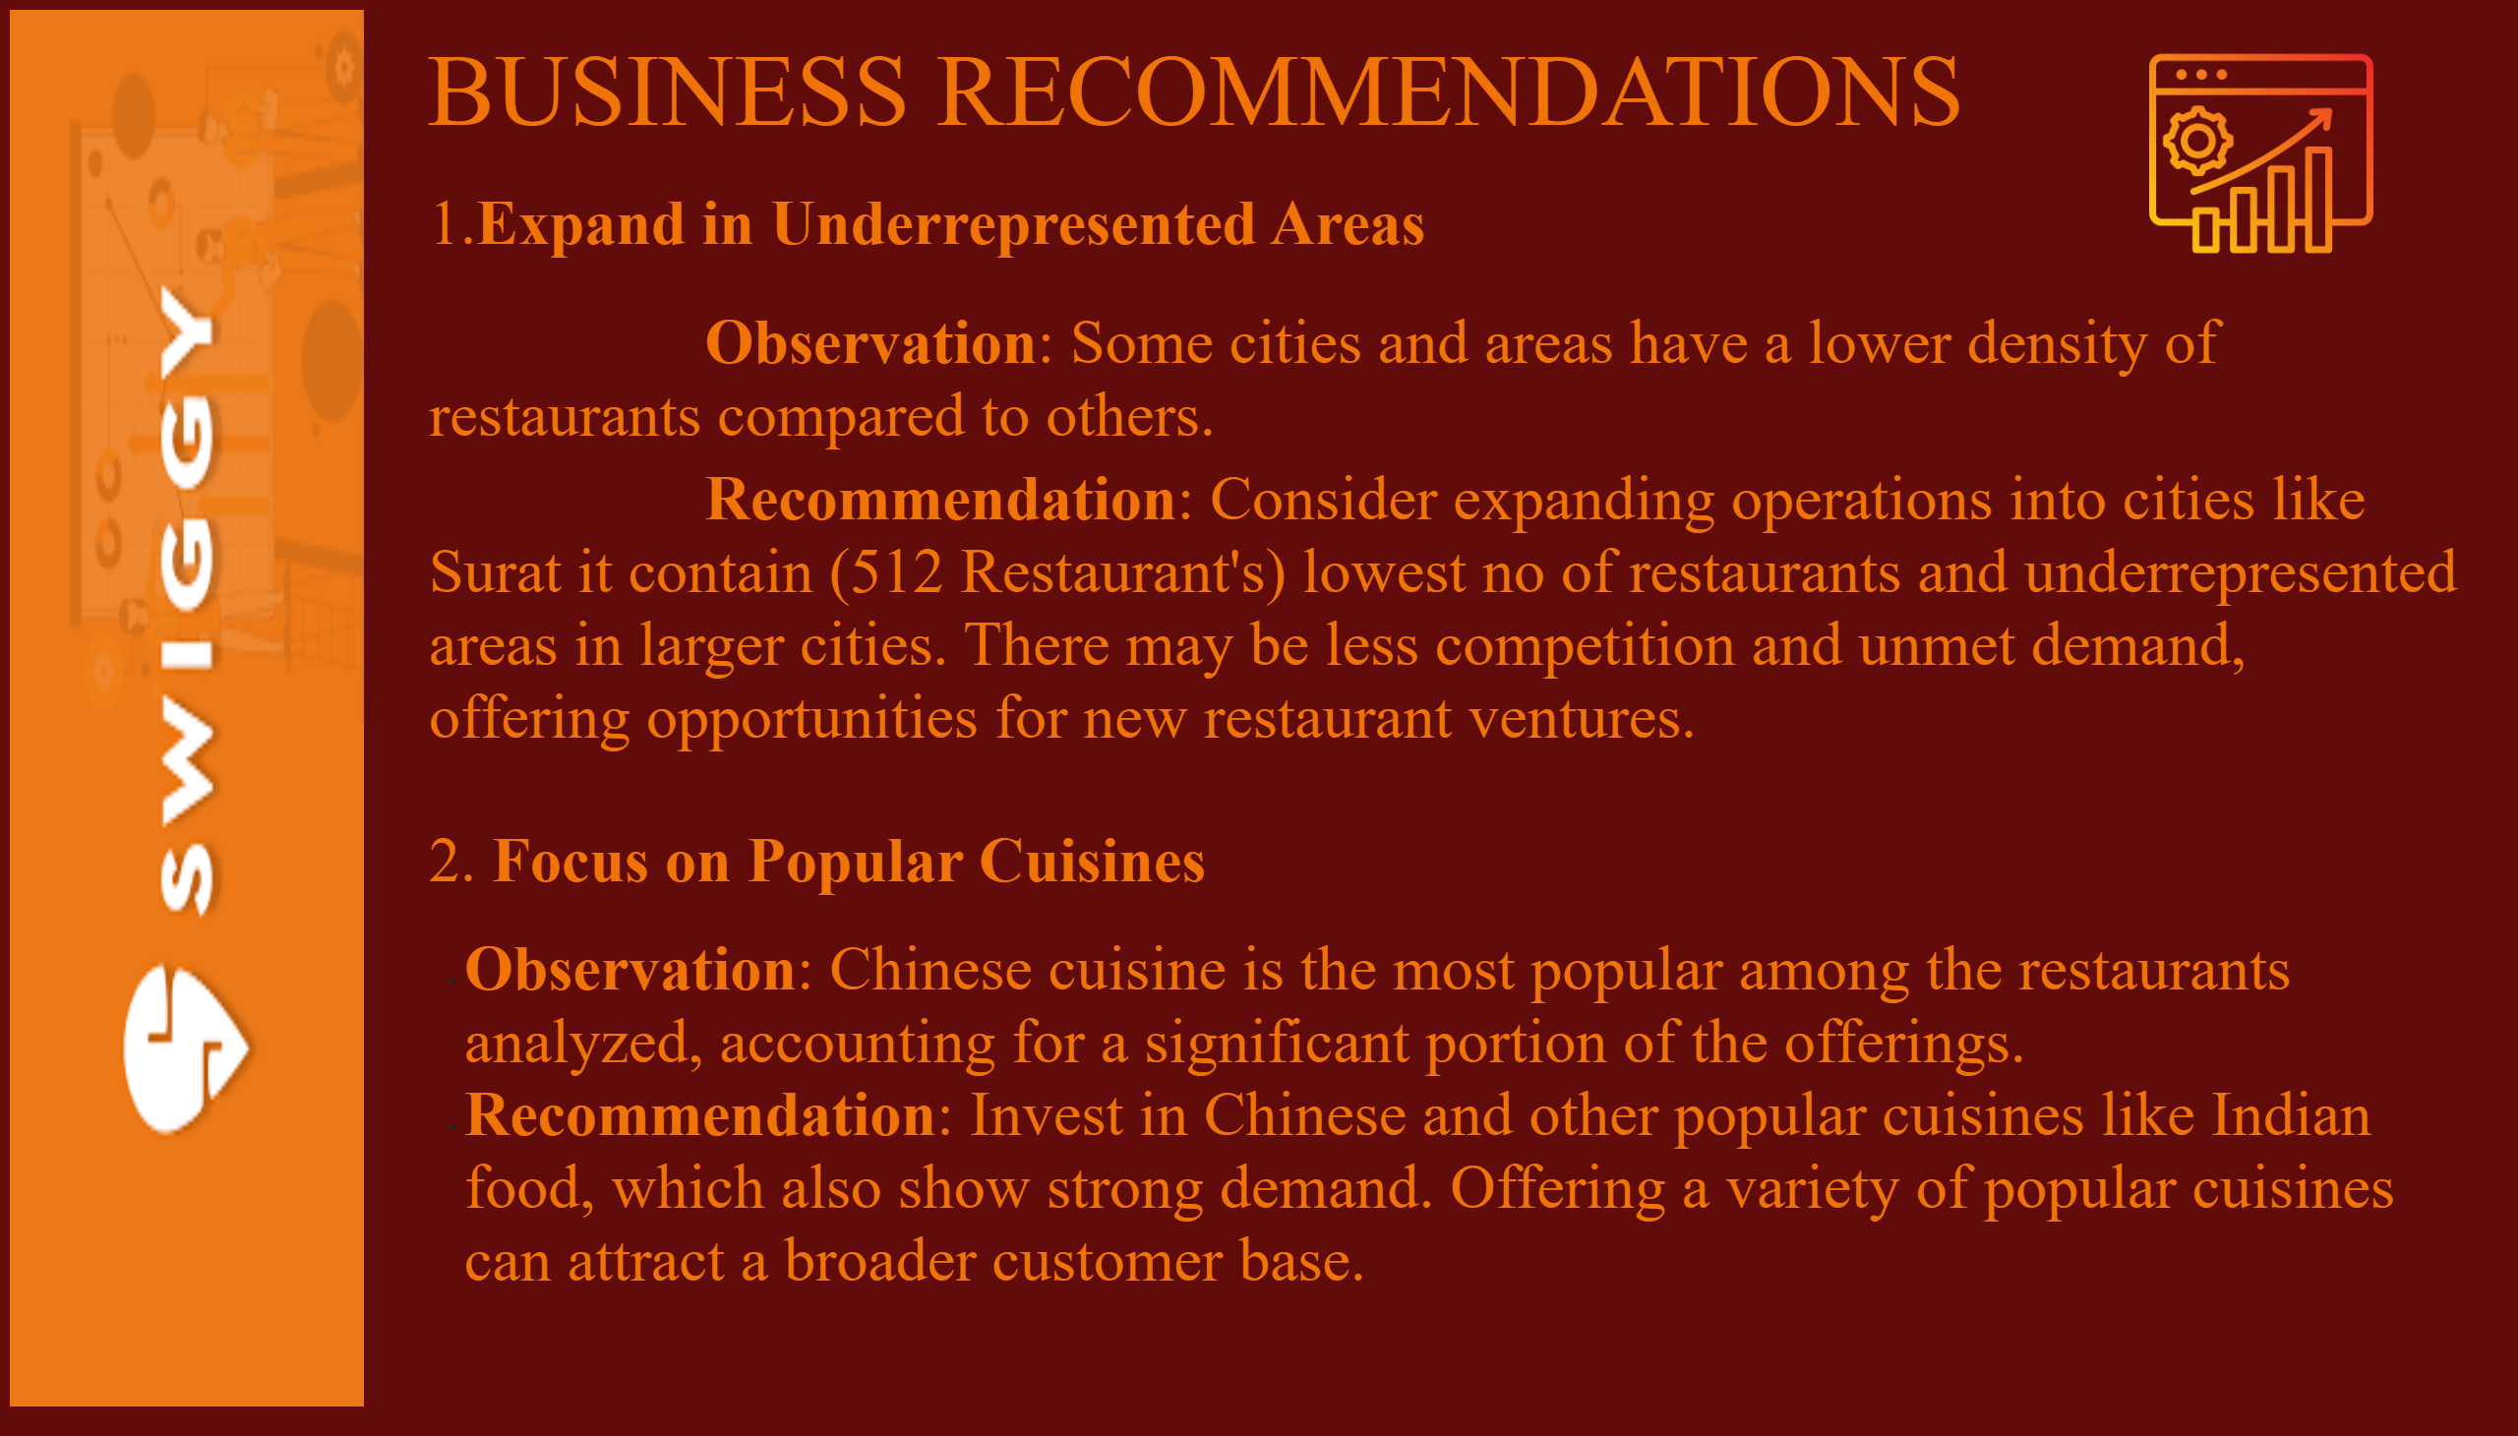
BUSINESS RECOMMENDATIONS
Notes:
image
No alt text provided
BUSINESS RECOMMENDATIONS
No alt text provided
textbox
No alt text provided
image
No alt text provided

Slide 24
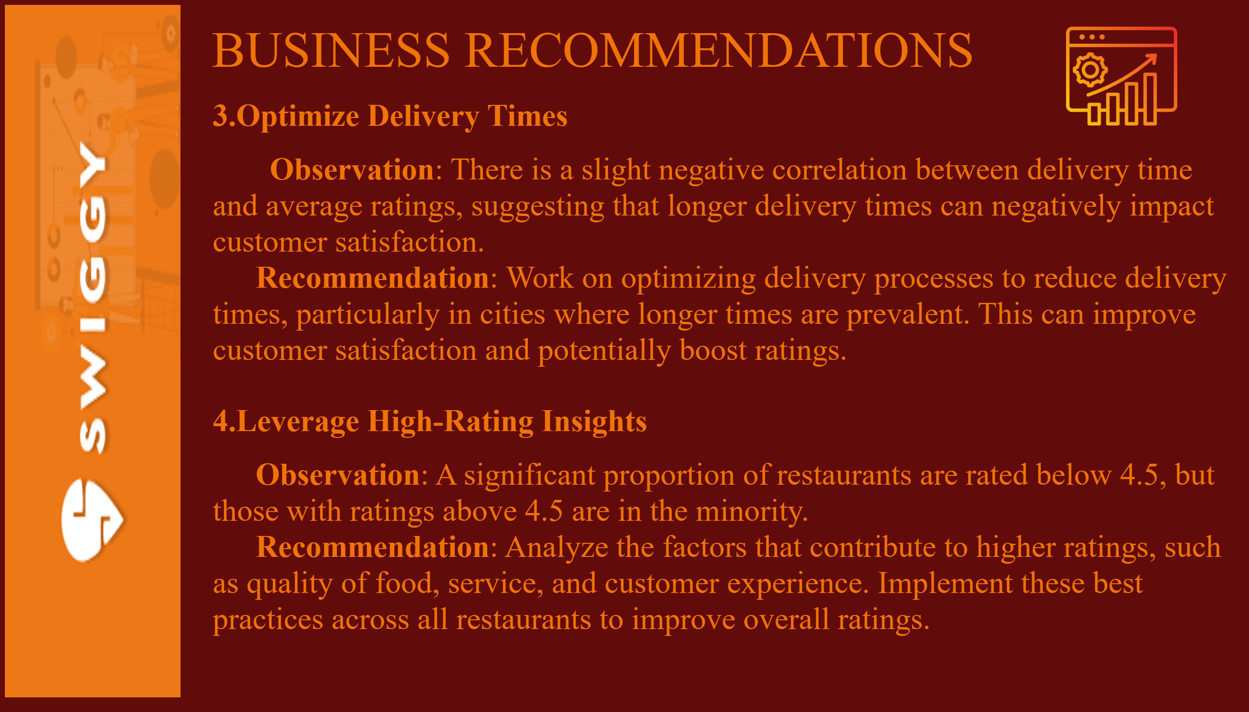
BUSINESS RECOMMENDATIONS
Notes:
image
No alt text provided
BUSINESS RECOMMENDATIONS
No alt text provided
textbox
No alt text provided
image
No alt text provided

Slide 25
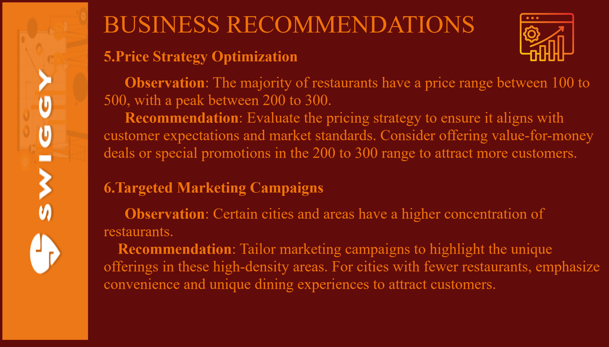
BUSINESS RECOMMENDATIONS
Notes:
image
No alt text provided
BUSINESS RECOMMENDATIONS
No alt text provided
textbox
No alt text provided
image
No alt text provided

Slide 26
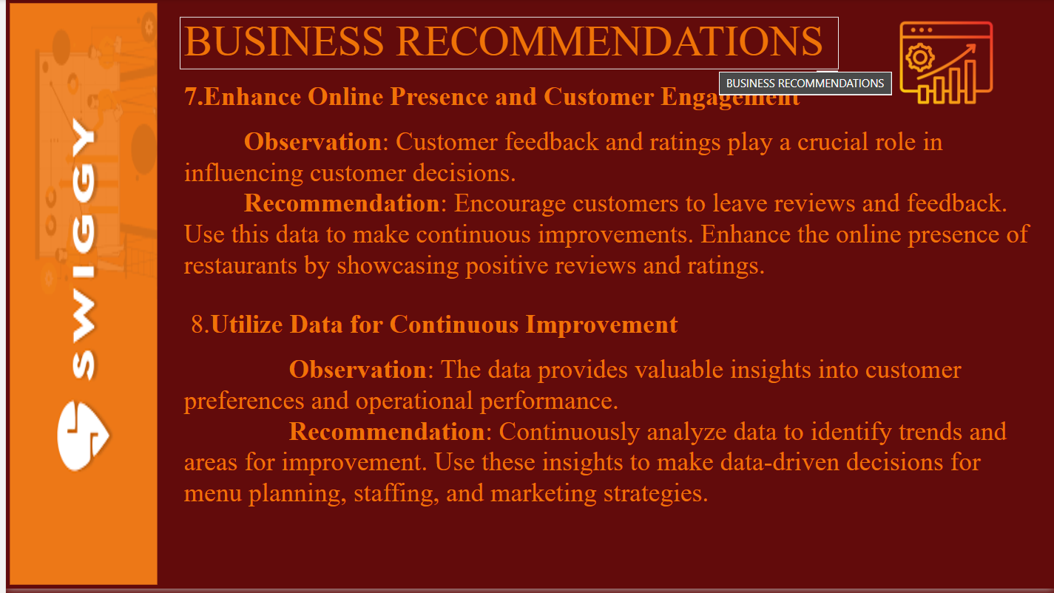
BUSINESS RECOMMENDATIONS
Notes:
image
No alt text provided
BUSINESS RECOMMENDATIONS
No alt text provided
textbox
No alt text provided
image
No alt text provided

Slide 27

thank you
Notes:
image
No alt text provided
textbox
No alt text provided
textbox
No alt text provided
textbox
No alt text provided

